Slide 1


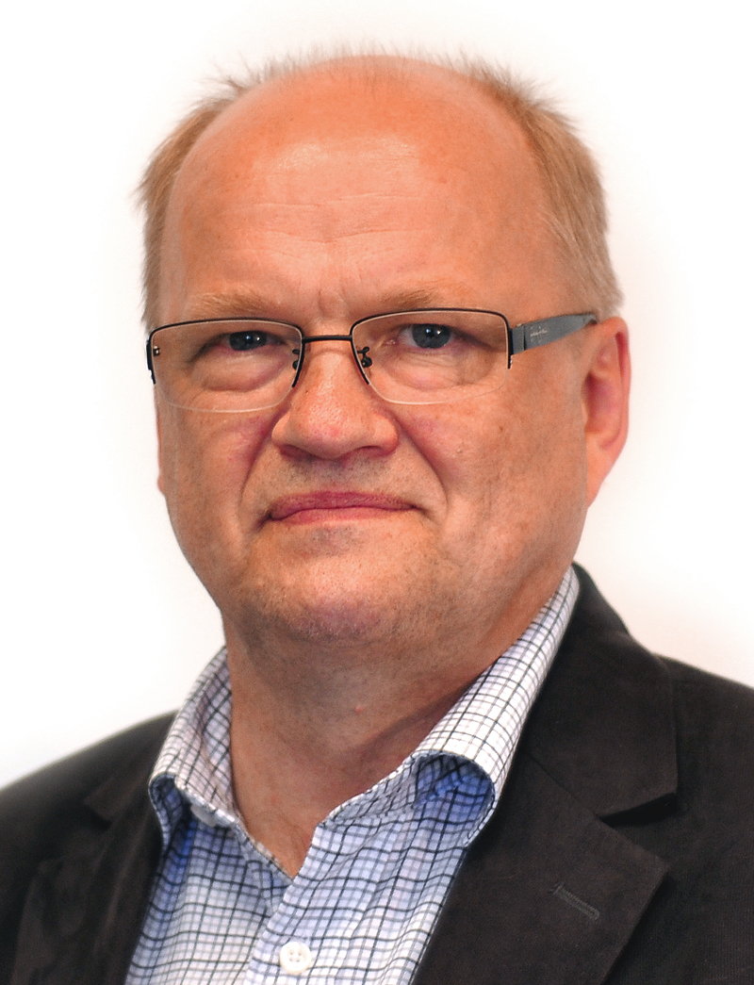
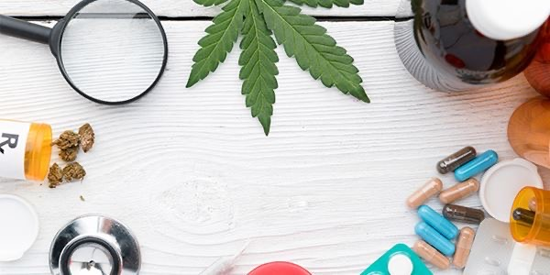
Tackling Drug driving in Sweden
Helsinki 27 May 2025
Lars Olov Sjöström
MHF Sweden

Slide 2
The Drug Driving problem in Sweden
A new report - Alcohol and drugs in fatal traffic accidents (2024)
The Swedish National Board of Forensic Medicine, on behalf of the Public Health Agency, has analysed the presence of alcohol and drugs in traffic-related deaths
The study covers the period 2012–2022
Drugs alone were identified in 23 percent, alcohol alone in 11 percent, and both alcohol and drugs in 5 percent.
Opioids were more common among older drivers, while cannabis was most common among younger drivers.
Reference: Folkhälsomyndigheten, Faktablad: Alkohol och narkotika vid dödliga olyckor i trafiken, Östersund 2024

Slide 3
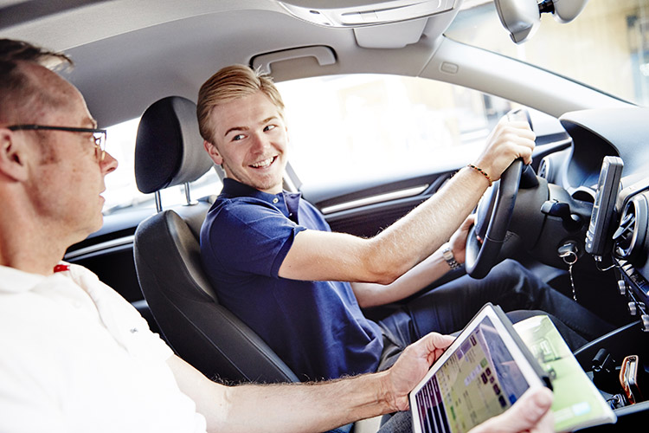
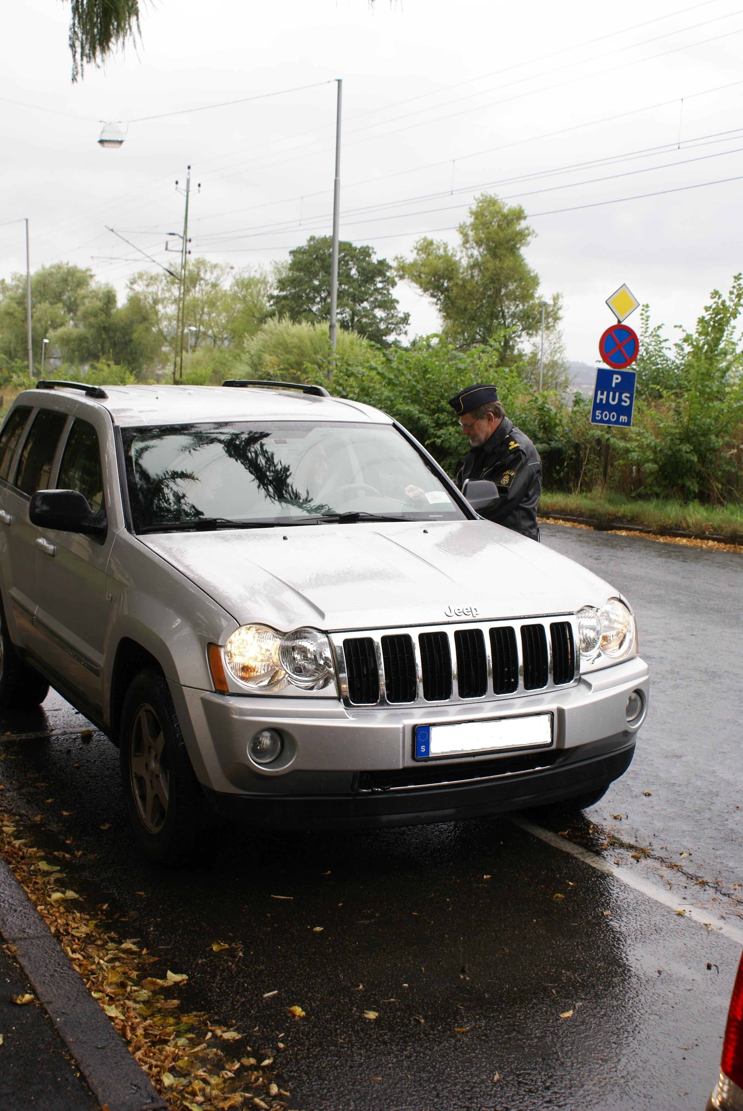

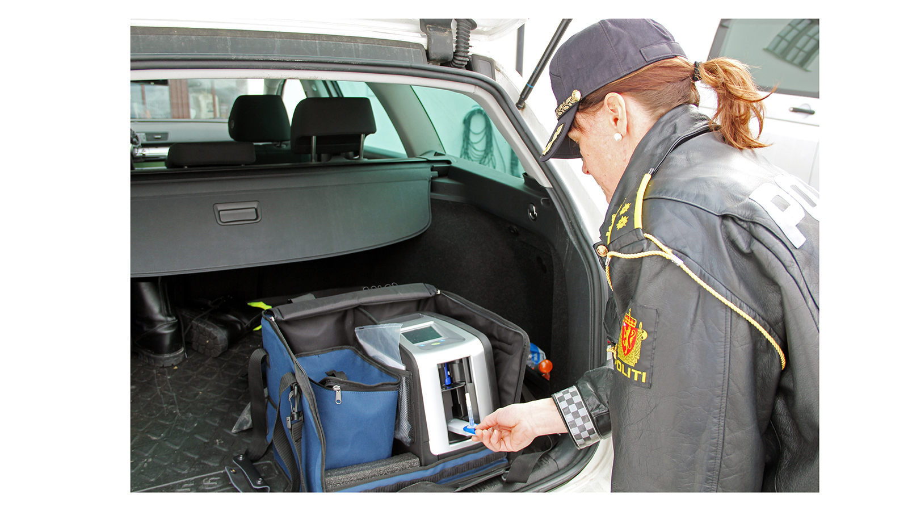
Preventive measures
Swedish Action Plan for safe road traffic - 33 measures for sober driving for the period 2022–2025
Sobriety support technology
Monitoring and control
Knowledge-improvement measures and influencing behaviour
Collaboration between stakeholders
Investigation and research.

Slide 4
Efforts against drug driving in Sweden - some examples
At every control contact with a driver of a motor vehicle, the police will perform an alcohol breath test and assess any symptoms of drug influence in the driver.
The Swedish Transport Agency (STA) works to promote sober driving by requiring that driving license holders not have alcohol or drug-related problems. If the requirements are not met, the authority revokes the driving license.
All doctors have a responsibility to report to the STA if a patient does not meet the medical requirements for a driver's license, for example due to certain medical conditions or drug abuse.
MHF is working for better tools for responsible authorities to check drivers under the influence of drugs and wants to introduce on-site drug tests in road traffic. MHF leads the work on standardization of on-site drug tests through a committee within the Swedish Institute for Standards (SIS)
The Swedish Transport Administration carries out information and awareness-raising measures for citizens and road users, in order to achieve a reduced proportion of alcohol and drugs in road traffic.
Every year, the Swedish Transport Administration invites external actors to a knowledge-raising webinar about Sober Traffic.
MHF works to ensure that traffic sobriety is given increased priority within public health work.

Slide 5


A survey of risk perception of driving under the influence of Cannabis in Norway and Sweden (2022)
Ipsos
Conclusions
The level of knowledge is low
Norwegians estimate lower risks at DUIC than the Swedes
More information is needed for the public
More research on risk level of DUIC necessary
DUIC and the effect on traffic safety should also be a topic in the current legalization debate
500 respondents in each country
Age 16 – 35 years
Survey carried out through e-mail and web link to an electronic questionnaire
The purpose: To get an overall idea of how younger people relate to cannabis and driving
Reference: Trender cannabis och trafik – en skandinavisk attitydundersökning, Sjöström & Fjellvang Kristoffersen 2022 (MHF and MA Rusfri trafikk)

Slide 6

Rapid Tests for Drug analysis – a new Swedish Standard Series
The purpose of the standardization work is to increase safety, quality and reduce costs for use.
On-site drug tests are increasingly used in workplaces and by various authorities (Police, Prison and Probation Service, Treatment Centers for substance abuse)
On-site drug tests are important tools for the police’s sobriety tests
Today there are no technical standards for on-site drug testing equipment in Europe
SIS/TS 70-1: Guidelines for Rapid Drug Testing – Part 1: Procurement, Implementation and Use – Published
SIS/TS 70-2: Guidelines for Rapid Drug Testing – Part 2: Saliva Testing – Forthcoming (prel. Aug. 2025)
SIS/TS 70-3: Guidelines for Rapid Drug Testing – Part 3: Urine Testing – Forthcoming
There is a great need for standardization for on-site drug tests at European level

Slide 7
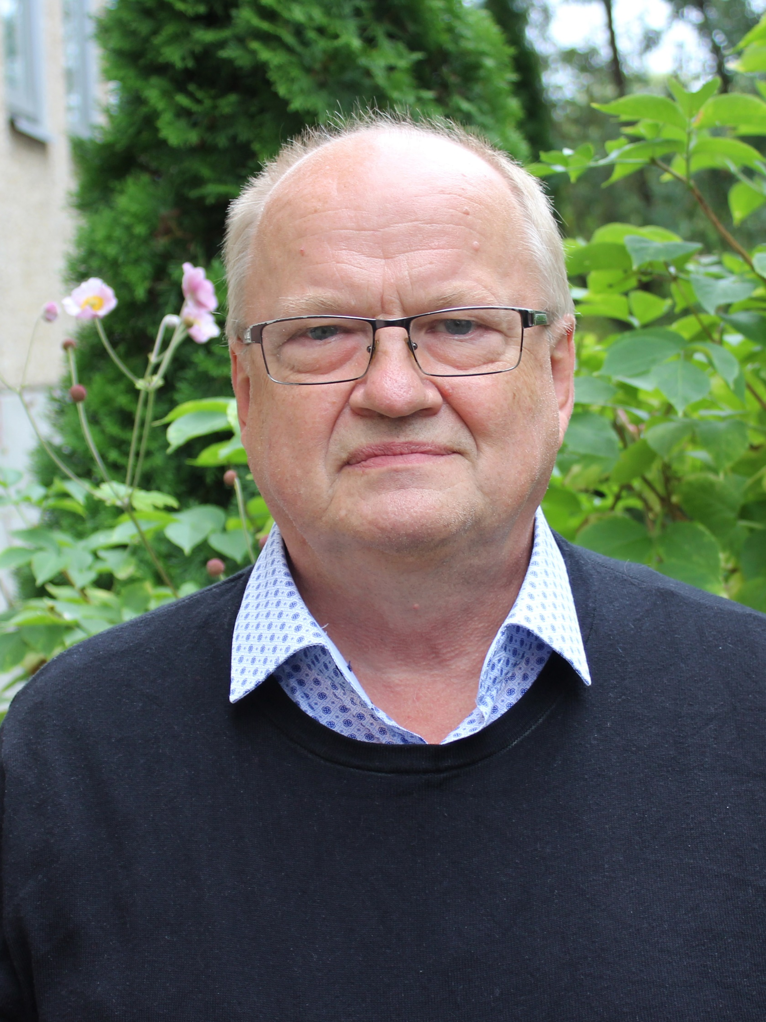
Thank you for your attention!
Contact:
Email: lars.olov.sjostrom@mhf.se
Phone: +4670 9291723

