Slide 1
Drug driving in the Netherlands
Sander van der Kint - SWOV

Slide 2
SWOV
Mission: Use knowledge of scientific research to improve road safety
All research is made public and available for the traffic professional
Data and analysis for policy
Traffic behaviour
Interaction with self-driving vehicles
Infrastructure

Slide 3
Status of drug driving in the Netherlands
Road fatalities: unknown
Due to privacy embedded in the Dutch constitution
Severely injured:
2.5% of victims were under the influence of drugs, 3.3% under influence of both alcohol and drugs
Information from medical emergency services following crashes (2021)

Slide 4
Drug prevalence? Also (mostly) unknown
Outdated numbers on prevalence (2011)
3.4% of car drivers were under the influence of drugs
Questionnaire studies (2022)
1% or 4% of drivers indicated to have driven under the influence of drugs
Pilot study (2021)
443 drivers randomly selected, 51 positive results, 26 were prosecuted (confirmed in blood)
Recent police reports
“Drugs have overtaken alcohol”

Slide 5
Why the lack of prevalence measurements?
Saliva screening
Transport of driver to medical facility
Blood sample collected by medical professional
Analysis at Netherlands Forensic Institute
Results sent to public prosecutor
Drivers gets a fine/prison/driver license taken and a course on drug driving
Time consuming
40% is rejected because the concentration of drugs is under the legal limit
Method of testing and prosecution
Police capacity

Slide 6
Drug driving in the Netherlands
A new approach was necessary
We know very little about the problem
General feeling that we are losing grip on the problem

Slide 7
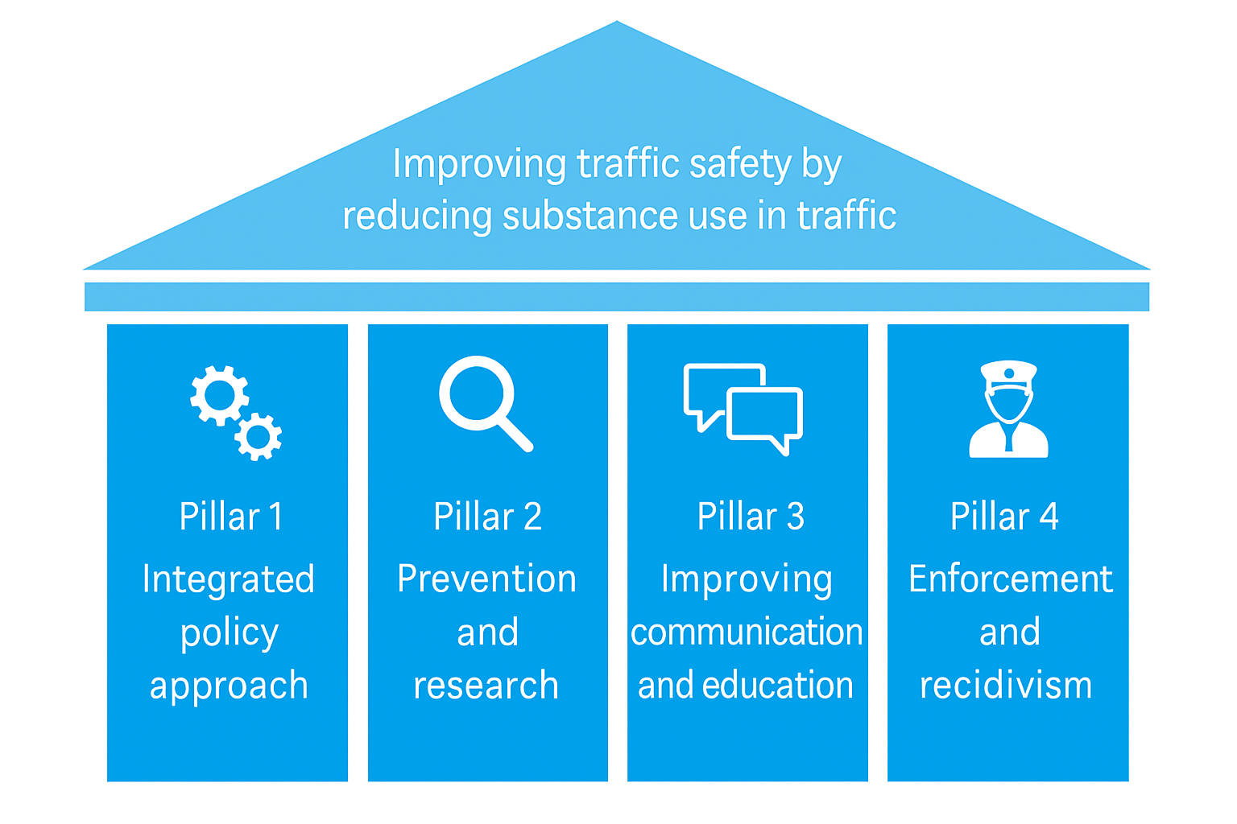
Integral approach to driving under the influence of both drugs and alcohol
Created by most stakeholders involved in driving under the influence -> finalized last year
Aims to identify which action to undertake to reduce DUI
Each pillar has “problem owners”
All lead by ministry of Transport
SWOV involved in the second and fourth pillar

Slide 8
Pillar 1: Integral policy approach
Improve cooperation between different stakeholders by ministry of Transport
  Connect stakeholders
  Activate and facilitate stakeholders

Slide 9
Pillar 2: Prevalence and research
Valid and trustworthy prevalence numbers
  SWOV: How to measure prevalence and how to reduce time for the police
More knowledge on the risks of DUI
Insight in specific subgroups of drivers who DUI
Improve data collection and expand possibilities of data collection

Slide 10
Pillar 3: Improve communication and education
Link driving under the influence to existing communication about and for substance users
Develop specific communication strategies for different target groups

Slide 11
Pillar 4: Improve enforcement and reduce repeat offenders
Increase the chance of being caught (both subjectively and objectively)
  SWOV: How to communicate police checks to improve this
  SWOV: What would zero tolerance mean for NL?
  SWOV: How can we improve detection of drug use in traffic?
Improve exchange of information between administratie and criminal law
Person-oriented approach to reduce rehabilitation and reduce repeat offenders.

Slide 12
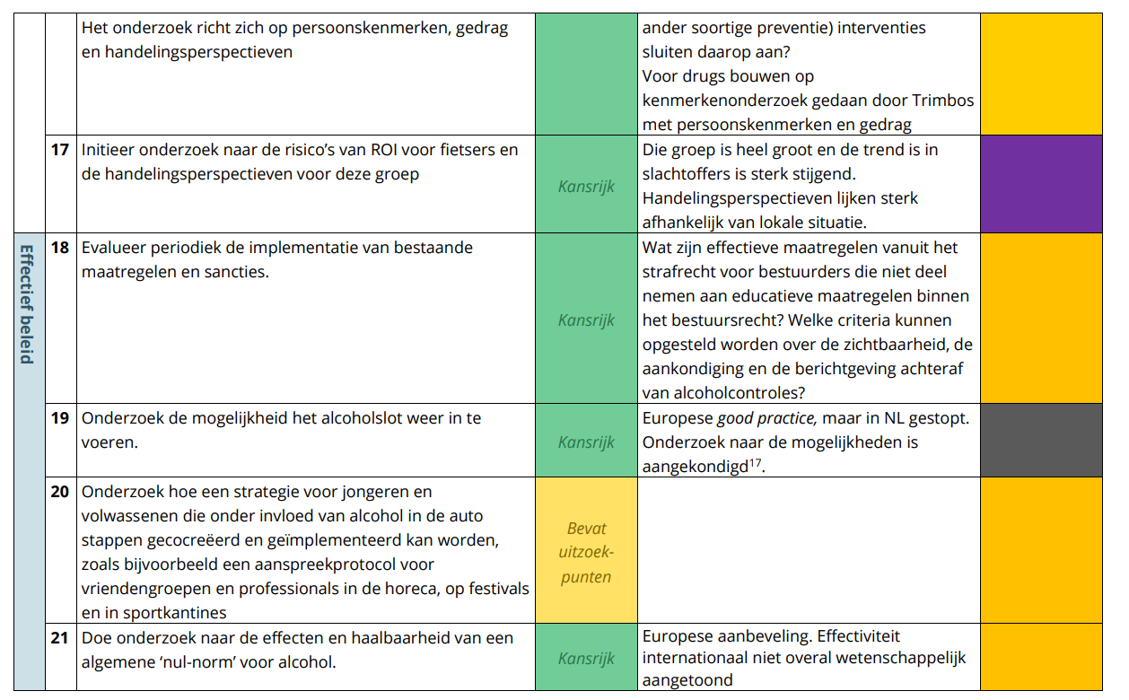
“Living” document
Stakeholder meetings and focusgroups to identify chances:
  Idea?
  What is needed?
  Try to get funding

Slide 13
Results?
No new policies on drug driving yet
Re-introduction of the alcolock

Slide 14
Questions?

