Slide 1



Alcohol ignition interlock program in

Slide 2
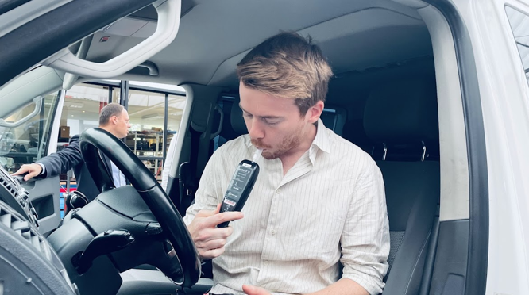

Content
Introduction: Vias institute
DUI situation in BE
The AIIP in BE
Things to consider
Credit to Ms Anneliese Heeren,
Federal Public Service Mobility and Transport

Slide 3





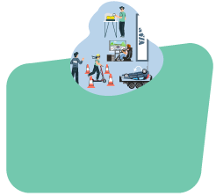


Our organisation
Knowledge Centre
Evaluation & coaching
Technical laboratories
Vias academy
PR, communication & marketing
Driving schools
230 employees
Vias institute, Co-operative recognized as a social enterprise

Slide 4

DUI in BE

Slide 5

Legal limits alcohol for driving:
0,5 ‰ BAC
(0,22 mg/l BrAC)
0,2‰ BAC professional drivers
(0,09 mg/l, BrAC)
Notes:
Random sampling method Baseline/Trendline project
Only cars and vans
A-selective

Slide 6
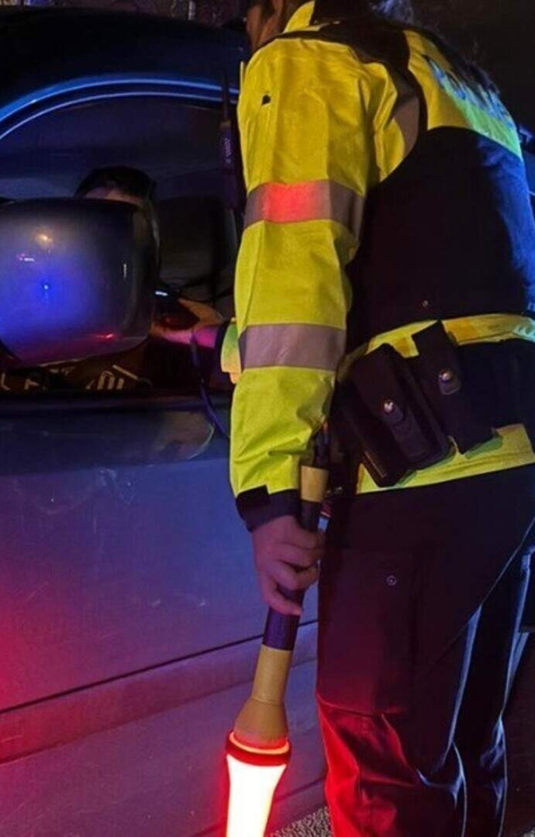
± 50 000 DUI drivers caught after injury crash: >10% test positive
± 40% of road crashes during weekend nights are linked to DUI
4 050 injury crashes involving DUI driver
= 11 / day average BAC =1,7 ‰
“% DUI decreases and N_checks increases”
Police Data (2024)
Notes:
13 000 drugs

Slide 7

Population estimate of DUI 2024: 1,4%
2021: 1,6%
2018: 1,6%
Regional differences: FL vs Wall: 0,8 % vs 2,0%
Less DUI on highways 0,5% than inside built-up area 1,9% and outside 2,0%
More DUI in Males (1,7%) than Females (0,9%)
The shorter the trip, the more limit is exceeded
Trendline data
Notes:
Random sampling method Baseline/Trendline project
Only cars and vans
A-selective
No age category effect

Slide 8

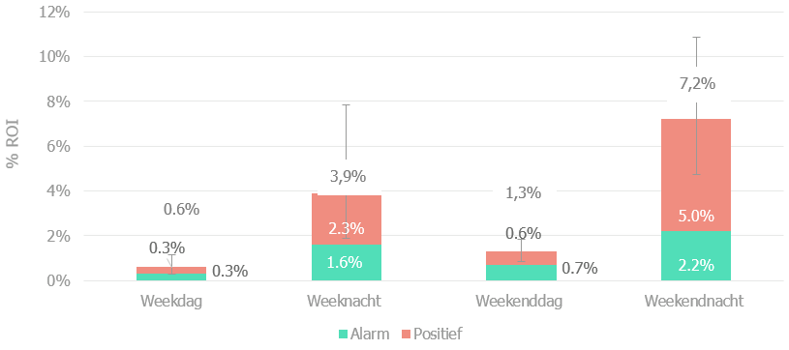
More DUI at night, even more pronounced in weekend
Trendline data
Notes:
Random sampling method Baseline/Trendline project
Only cars and vans
A-selective

Slide 9
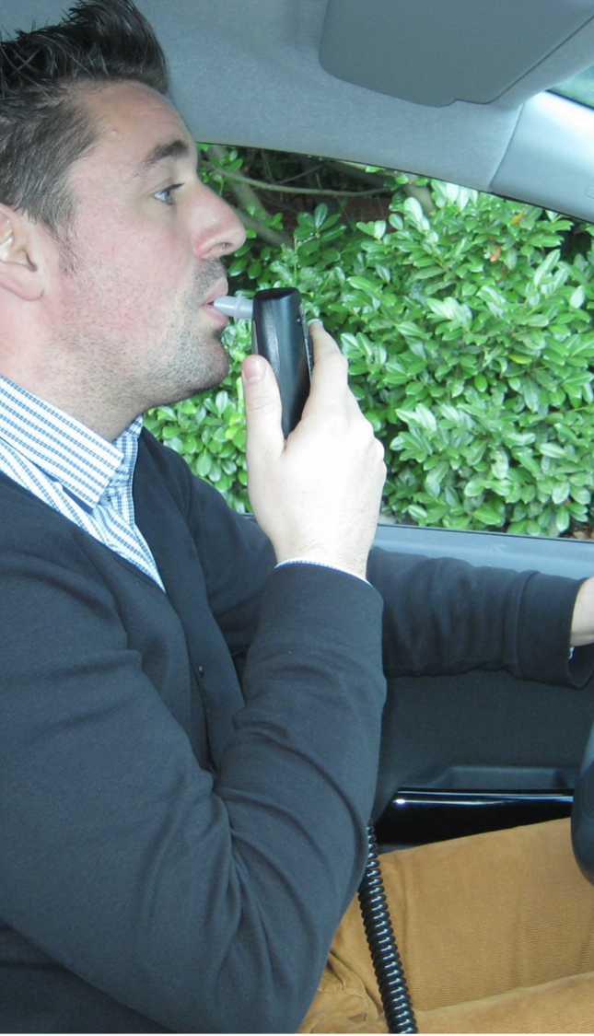
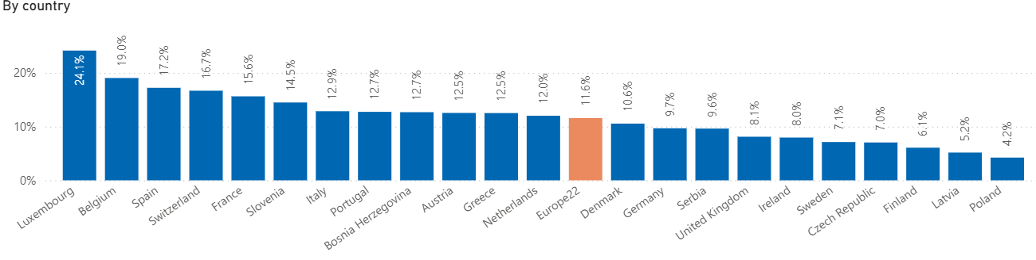
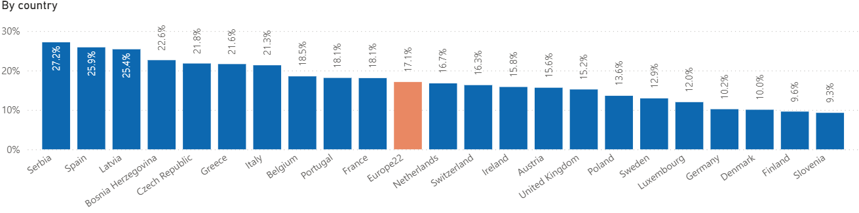
Over the last 30 days, how often did you as a car driver, drive when you may have been over the legal limit for drinking and driving?
ESRA data
On a typical journey, how likely is it that you will be subjected to a breathalyzer test?
Notes:
ESRA: self reported behaviour
DUI
Probability of being checked

Slide 10
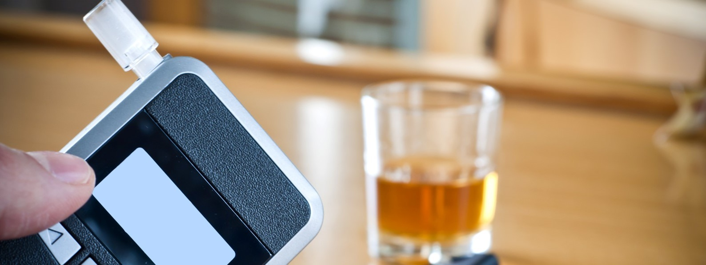
Alcohol ignition interlock in be
What?

Slide 11

RD 2010 judge can impose
>0,8 ‰ BAC drunkenness or recidivism
1-5 y, ∞
Law 2018 mandatory imposed
≥ 1,8 ‰ BAC, except ….
Recidivism ≥ 1,2 ‰ BAC, no buts
1-3 y, ∞ can impose
≥ 0,8‰ BAC drunkenness or recidivism
Notes:
1,8 pm in bloed is 0,78 mg/l BrAC/ 1,2 pm in bloed is 0,5 mg/l
2x within 3 years

Slide 12
Targeted population:
“heavy drinkers” high BACs / repeated DUI
To know / peculiar: judge can exempt certain DL Cat’s eg bus/truck except Cat of offence
Out of scope:
‘alcohol addiction’ (driving ban) driving ban for life
Notes:
2x within 3 years

Slide 13
Number of interlocks for offenders
2010: 1st legislation
2013: 1st device installed
2014: 7 offenders convicted
<-2017: only 66 persons in monitoring program
2018: 2nd legislation
2019: 165 installations (>2900 convictions)
2020: 600 installations (>3800 convictions)
2021: 860 installations
2022: 960 installations
2023: >1000 installations
2024: 1282 installations
Today: about 2200 current AII drivers

Slide 14
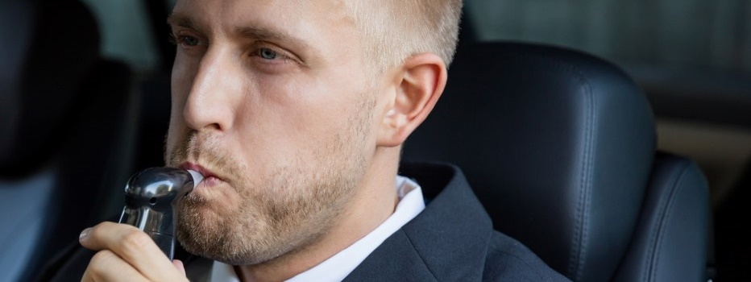
Alcohol ignition interlock in be
HOW?

Slide 15
Monitoring program: roadmap
Notification of the judgment by
public prosecutor
Person contacts accredited monitoring centre
Training and guidance by psychologists
3 years professional experience
Trained on risks and consequences of DUI and breath alcohol
No medical follow-up
Introductory meeting with 2w to explain the program (device, costs, driving licence, follow-up, data downloads, …)
Notes:
Notification: Choice to make: Alcohol Ignition Interlock Program or no more driving during the same period

Slide 16
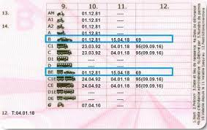
Monitoring program: roadmap
Training - within 30 d- on how to use the device, consequences of circumventing the system, risks and consequences of DUI, breath alcohol
Driving licence needs EU code 69 - within 30 d
Installation of the device in accredited service centre – within 30 d
4-8 M later: 3h training to share experiences, intentions and strategies to separate drinking and driving

Slide 17
Monitoring program: roadmap
Periodic downloads of registration unit by service centre every 2 months (after 1 year every 6 months)
Data stored on a secured place and only readable by monitoring centre
Every time an evaluation of these data by monitoring centre individual guidance interview
whenever necessary and at least twice a year
Closing meeting
Removal of device

Slide 18
Monitoring program: roadmap
Notification
Introductory meeting + Training
Individual guidance after download (every two months)
Installation
Training
Closing meeting and approval for removal

Slide 19

Alcohol ignition interlock in be things to consider

Slide 20
Costs
1 year: € 3500
3 years: € 6000
30-35%: monitoring program
How to lower the costs?
Pay by instalments
Devices to rent
Open market for monitoring centres, service centres and model-approved devices
65-70%: device and downloads
Judge can allow deduction from the fine
Notes:
Recidive 1600 EUR fine

Slide 21
Lessons learned
Persuade and even impose judges (while preserving a degree of judicial discretion)
Monitoring program as a game changer
Several manufacturers: lower prices, allow rental
Territorial coverage of service centres and monitoring centres
A program/sentence of 5 years is too long
Keep device afterwards - helps keeping up good habits (without program)
Threshold at 0.2 ‰ (zero tolerance)
Annual verification of device by an accredited body (independency)
Notes:
3 devices: Dräger (Krautli), ACS (Rauwers & Alcolock Belgium), Smartstart – in preparation

Slide 22
To be improved
Time gap between offence and sanction: 12 - 18 M
Retest while driving to counter circumvention (retest to be completed within 15’)
Judges often opt out if they can (first offenders, regional differences)
Combination of driving ban (+test) + interlock = complex
No standard medical check: quid Alcohol Use Disorder (driving ban)?
Financial cost
Criteria to impose Alcohol Ignition Interlocks
Allowing greater flexibility within the program
Notes:
Quid om de 2M?
Quid onmiddellijk bespreken bij incident?
Quid alcohol addiction?

Slide 23
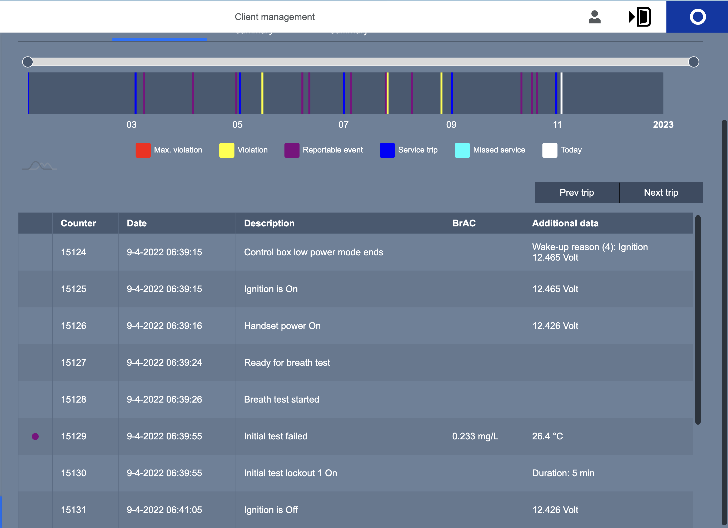
Notes:
Blauw: periode
Paars: alcohol gedecteerd
Geel: pre-offence
2xgeel: bijna rood (volgende is rood) en onmiddellijk download

Slide 24
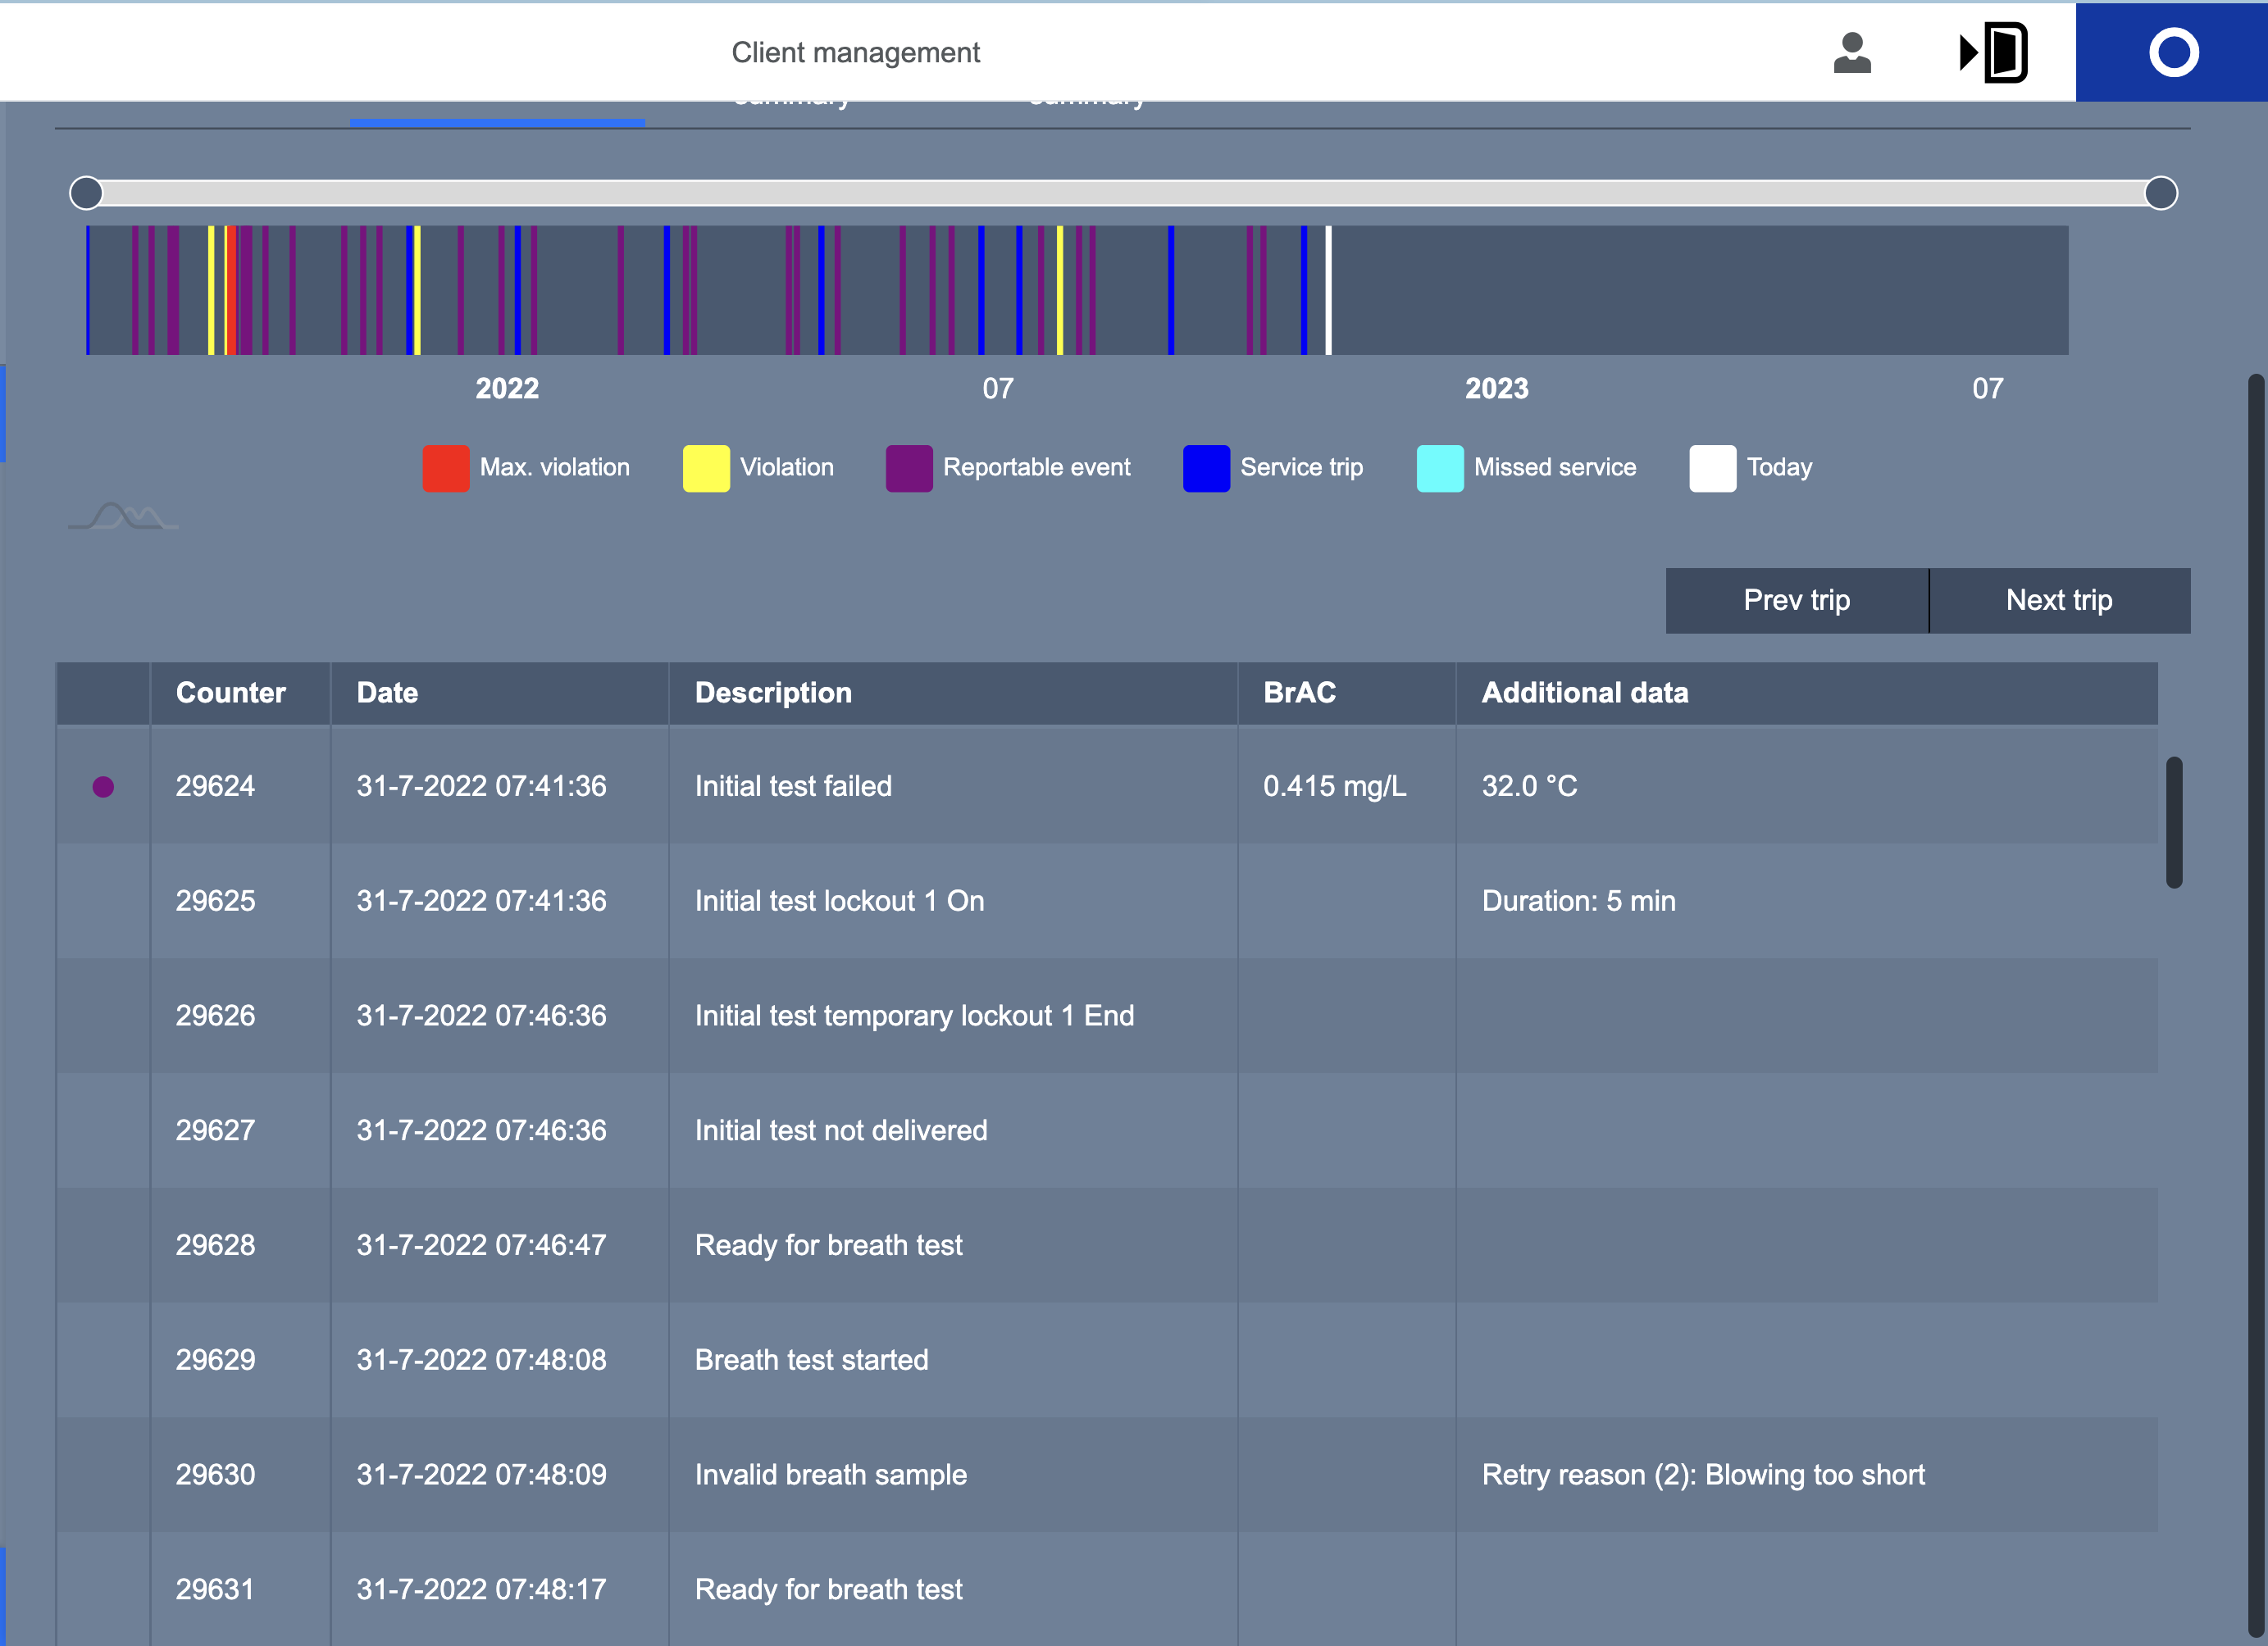
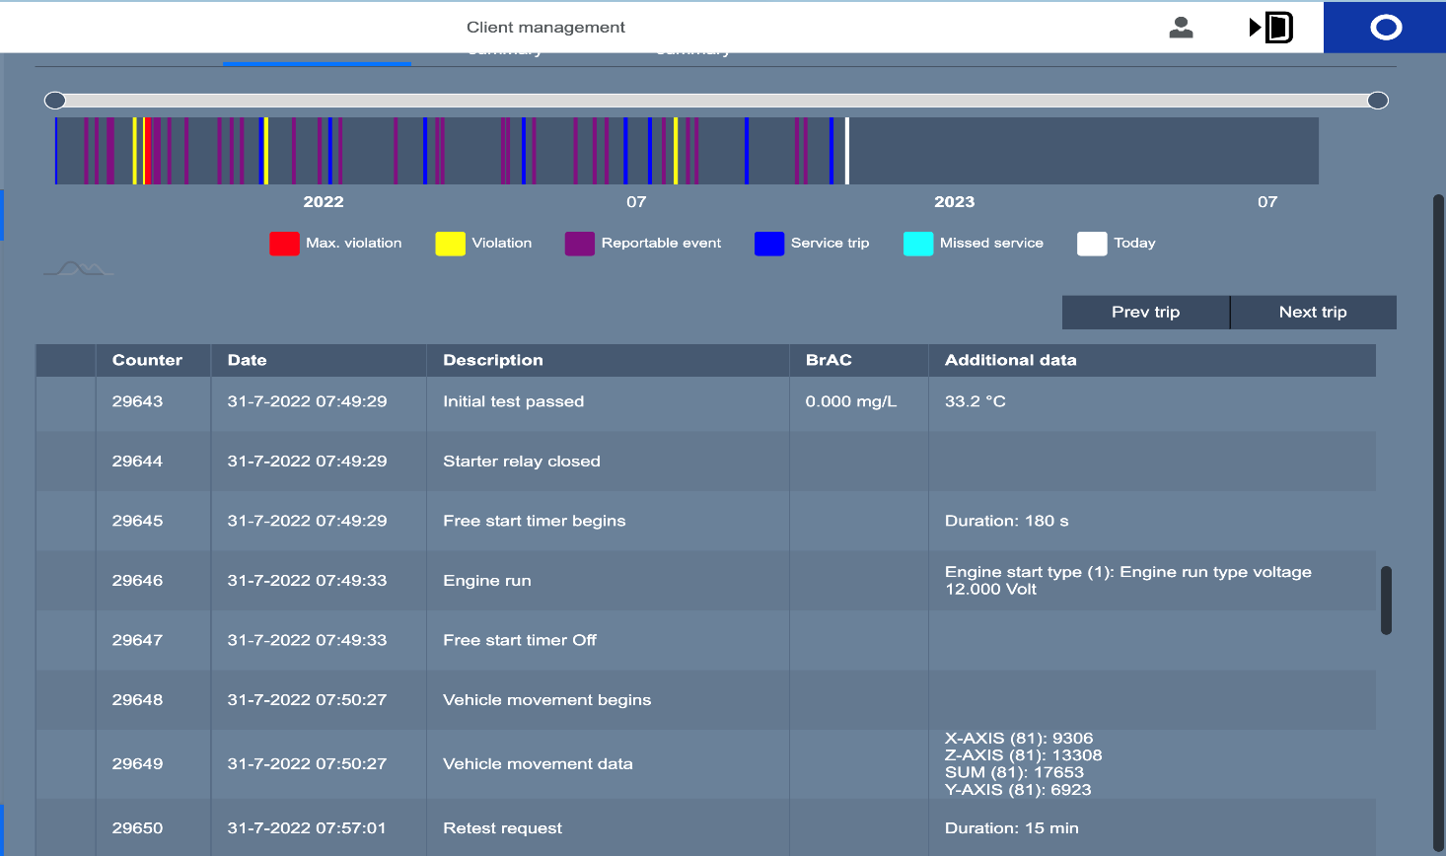
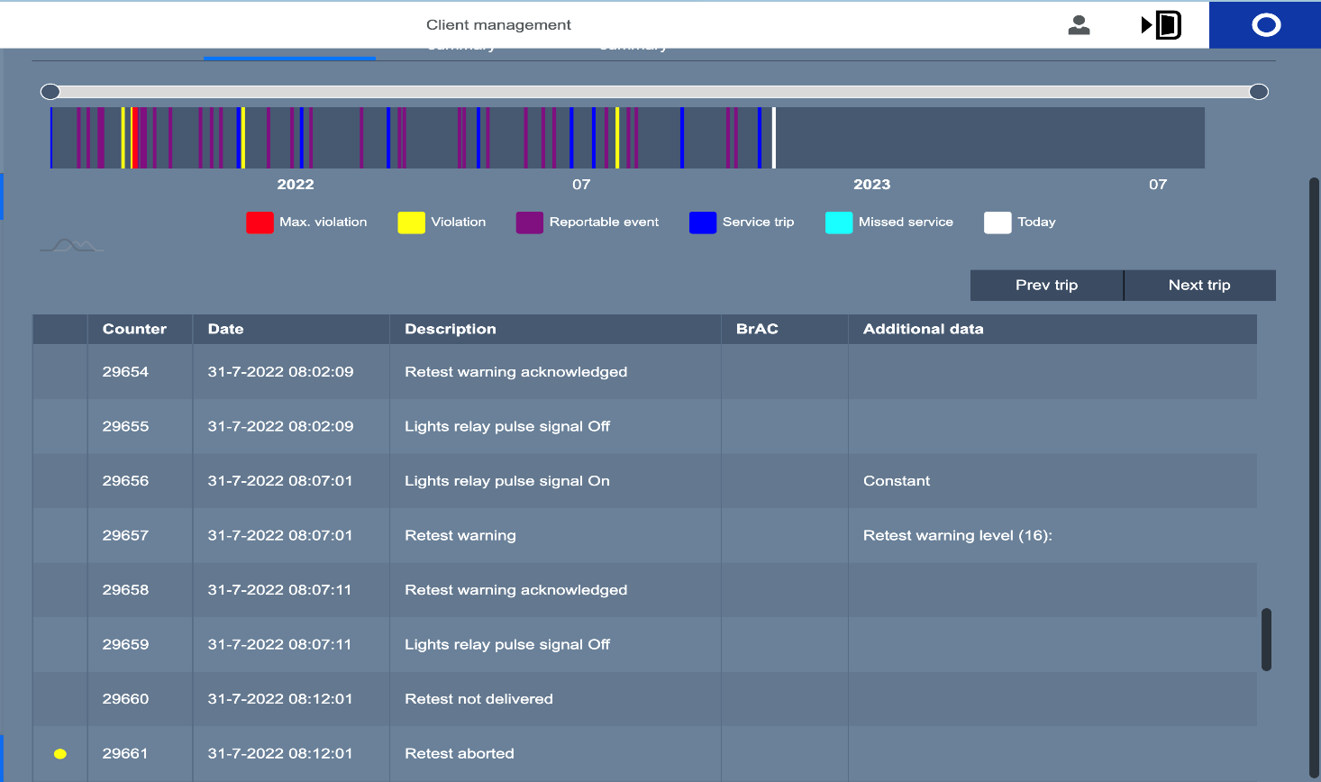


Slide 25

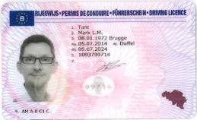
Mark Tant, PhD
mark.tant@vias.be
Manager CARA
Expert Fitness to Drive
Senior Researcher
www.vias.be

