Slide 1
Don’t Drink and Drive
Sweden

Slide 2

Focus areas in Sweden
Speed
Sober driving
Bicycle safety
Pedestrian safety
Suicide prevention
Leadership

Slide 3
Swedish consensus
There is no other area where there is such a public support as in condemning drunk driving!

Slide 4
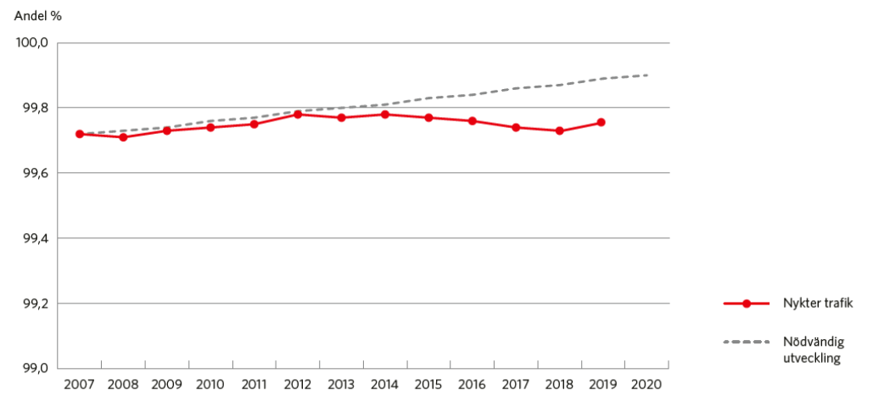
The dilemma
Sober traffic
%
Sober traffic
Necessary
development

Slide 5
Traffic Safety Survey
Do you think all cars should have Alcohol Interlocks?
Yes
85%

Slide 6
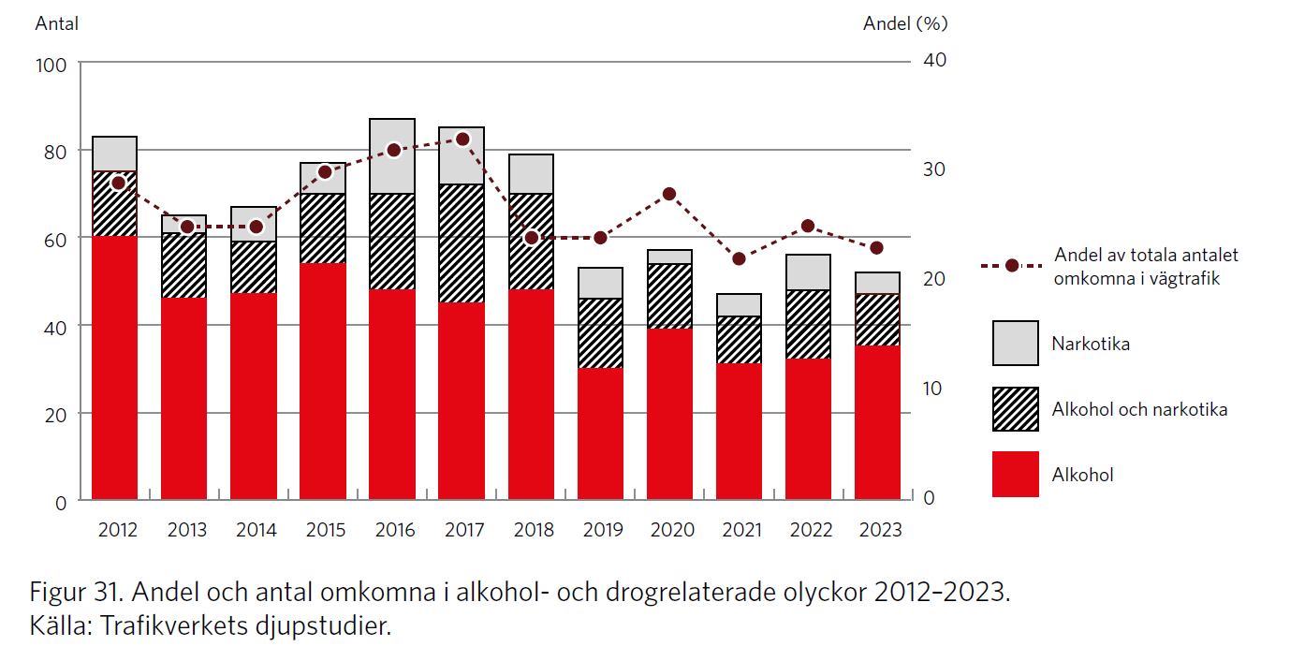
New way of measuring
Number of persons killed
Share
Share of total number
of killed in road traffic
Drugs
Alcohol and drugs
Alcohol
Share and number of killed persons in alcohol- and drug related crashes 2012-2023
Source: In-Depth-Investigations of fatal crashes

Slide 7
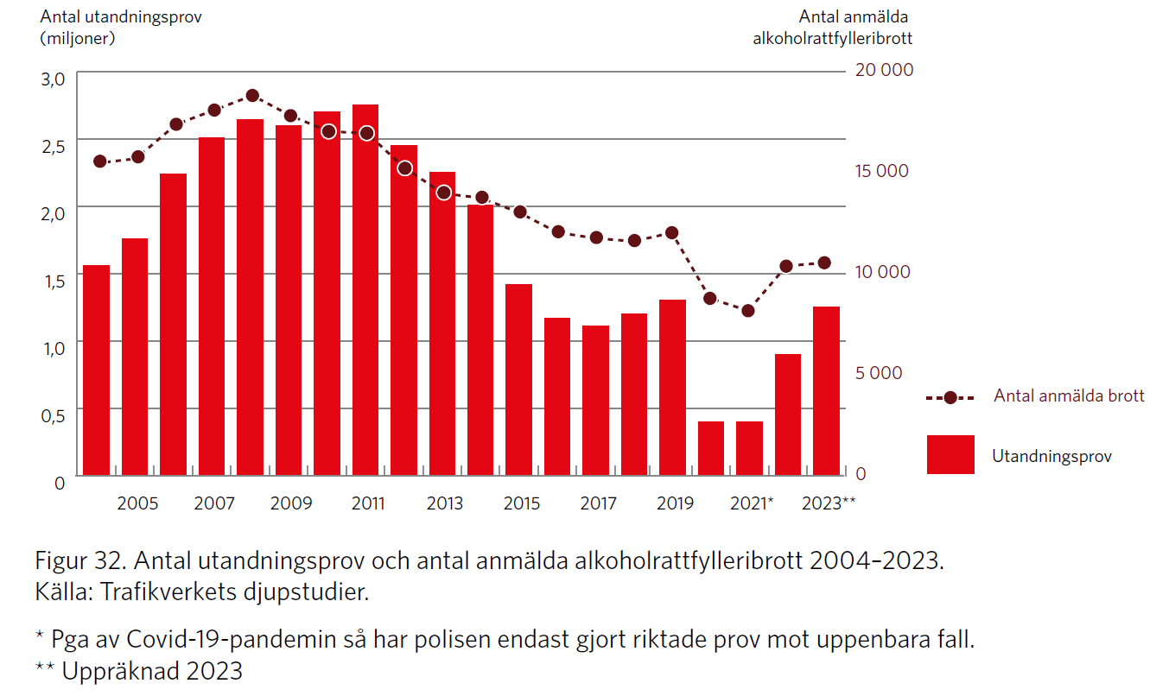
Number of reported
drunk driving reported crimes
Number of reported crimes
Breath test

Slide 8
Drink-driving and Alcohol Interlocks
0,2 ‰

Slide 9
Actions
New Technology
Surveillance
Capacity building
Collaboration
Research

Slide 10
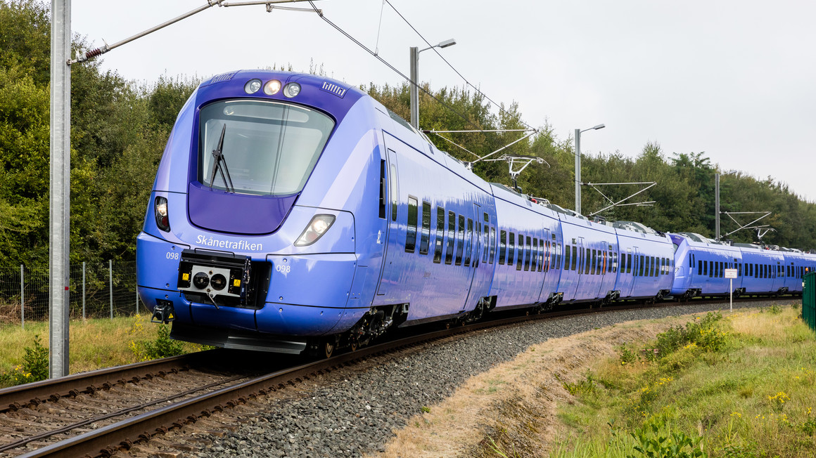
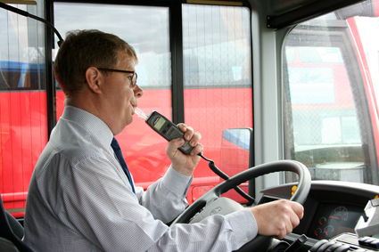
The coach example

Slide 11
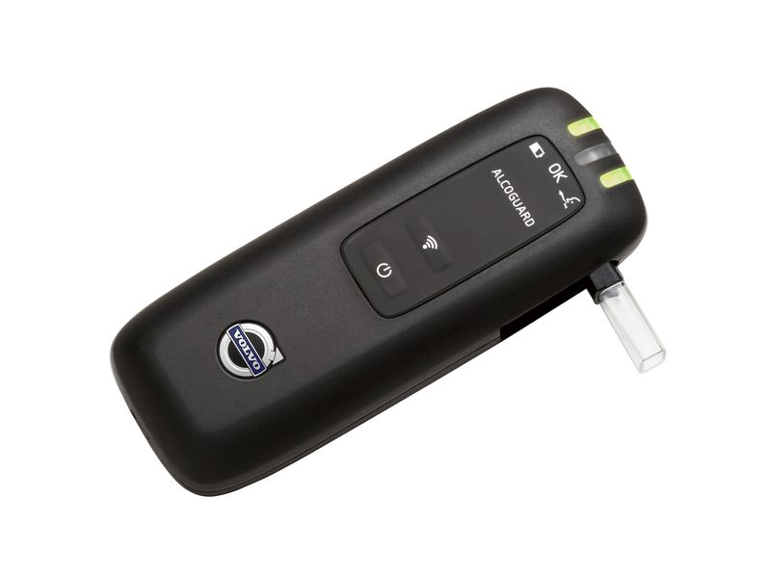
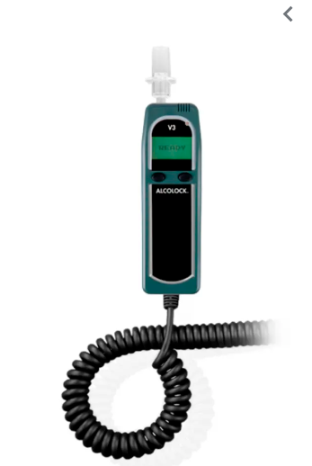
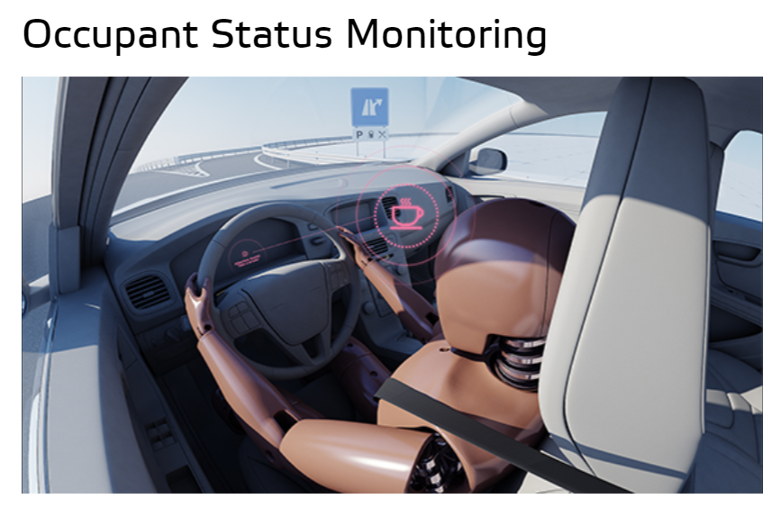
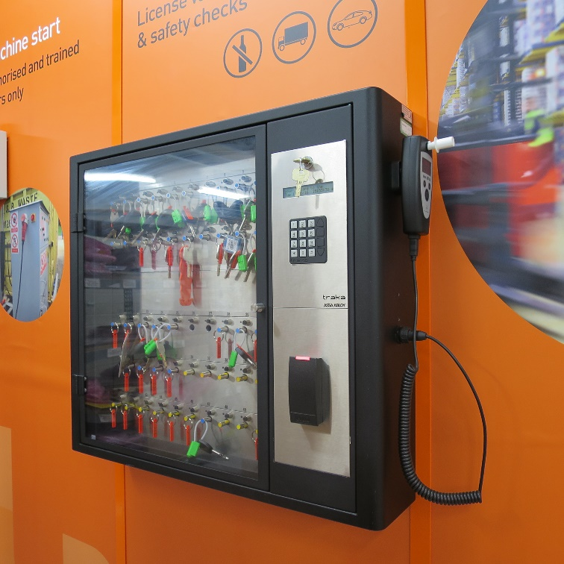
New Technology
Notes:
Alcobommar
Nyckelskåp

Slide 12
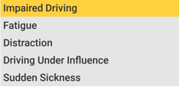
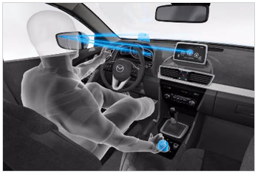
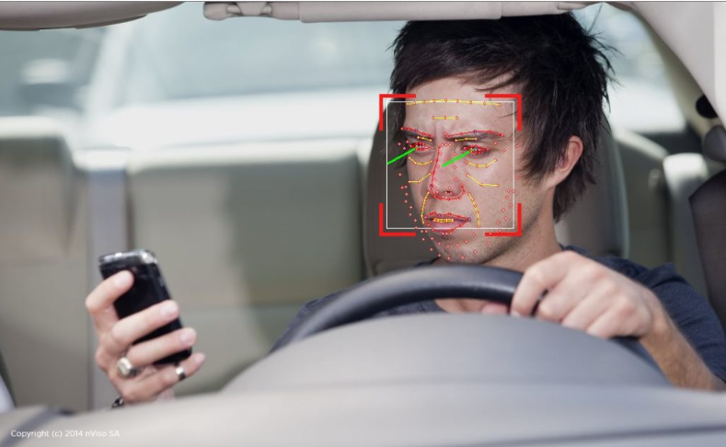
Driver State Monitoring
© Seeing Machines

Slide 13
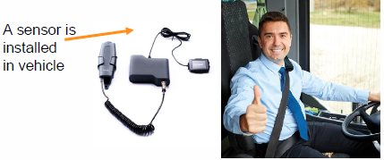
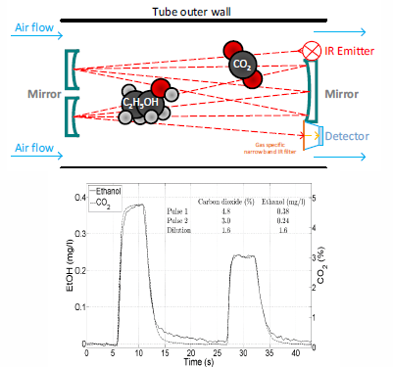
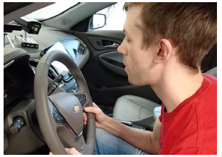
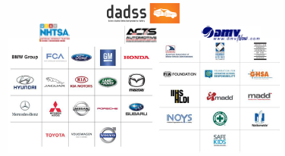
Alcohol detection – touch-free detection

Slide 14
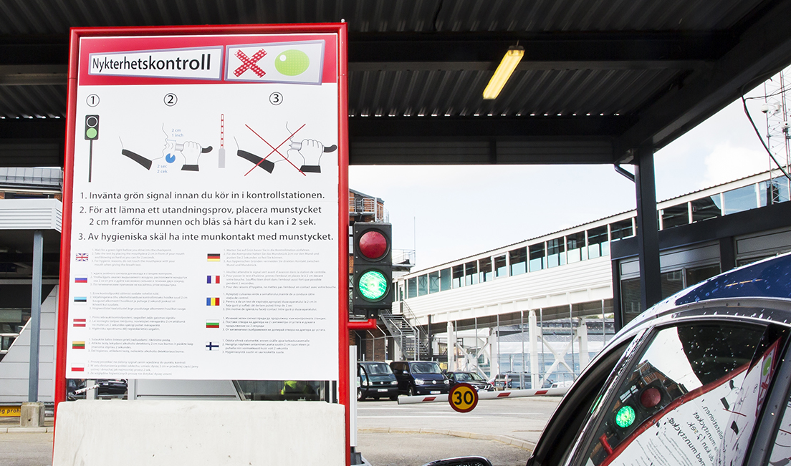
Alco gates

Slide 15
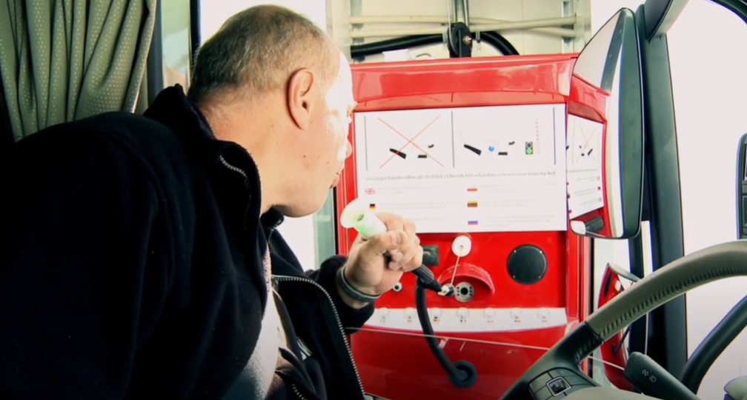
Alco gate

Slide 16

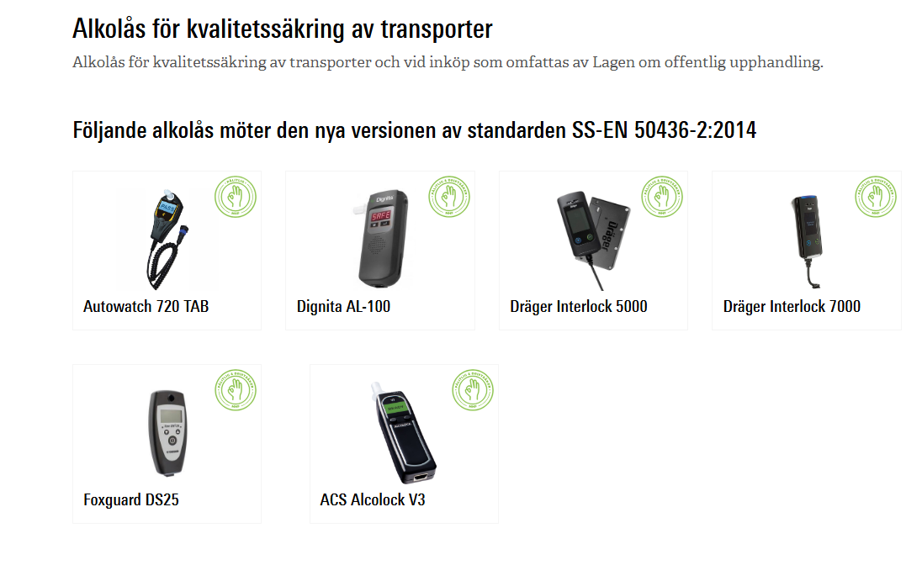
CENELEC (European Committee for Electrotechnical Standardization)
https://www.mhf.se/alltomalkolas/koprad/alkolas/produkter-och-omdomen/

Slide 17
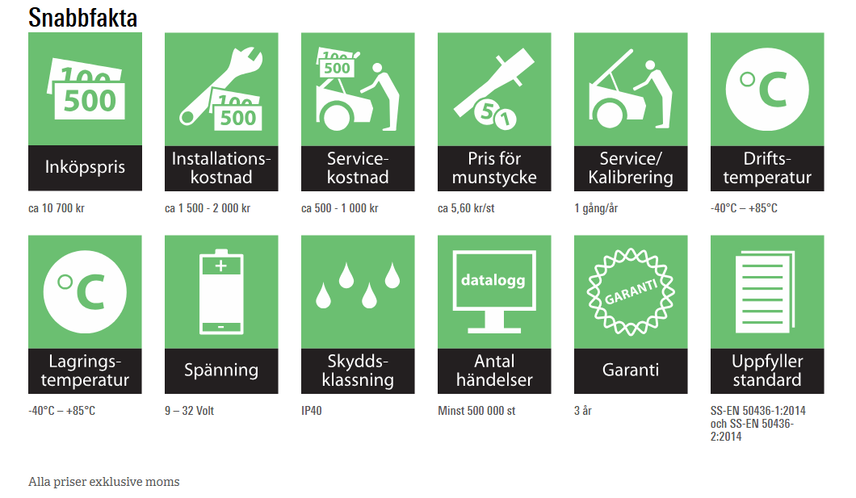
Facts about each product

Slide 18
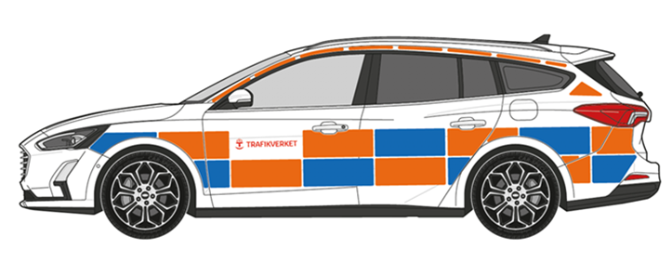
Alcohol lock in our own cars

Slide 19
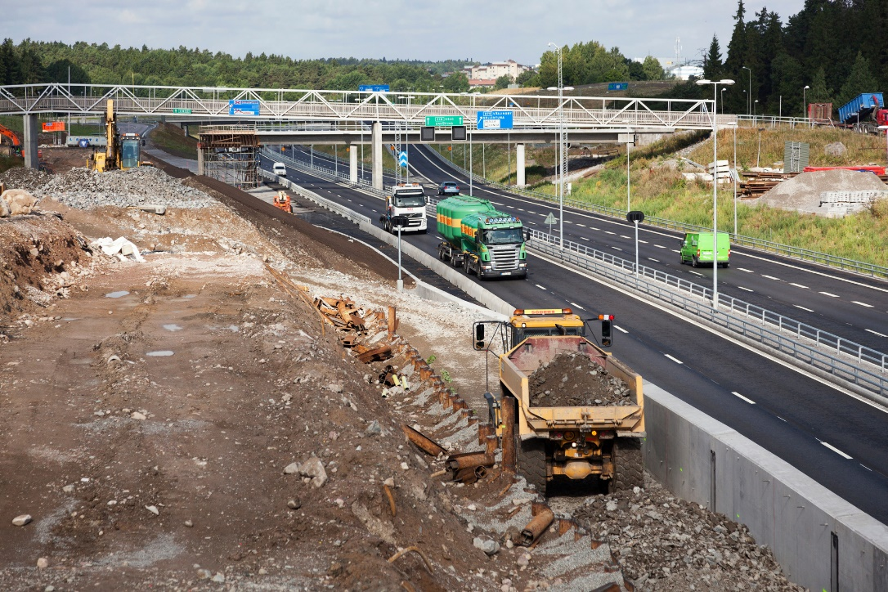
And in all our projects!

Slide 20
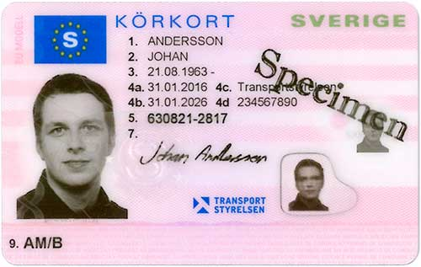
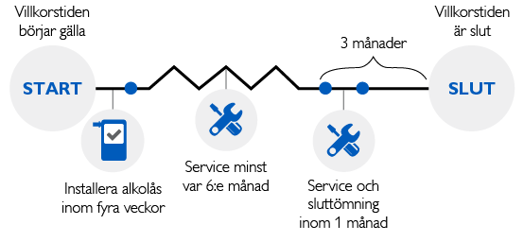
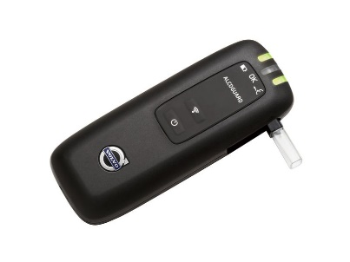
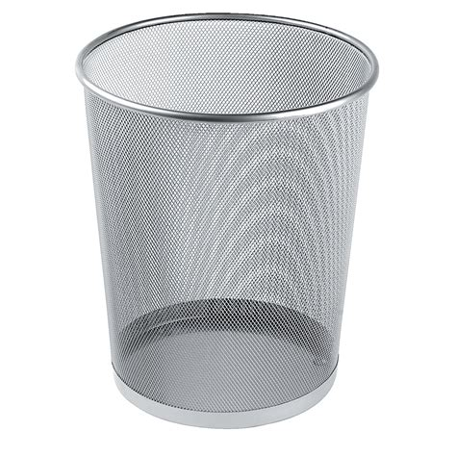
Alcohol Interlock programme
You risk to get your driving licence withdrawn 1 or 2 years
Driving licence in EES-country
Permanent living in Sweden
Start
End
Service
logging,
medical checks
Service
and logging
Installation

Slide 21
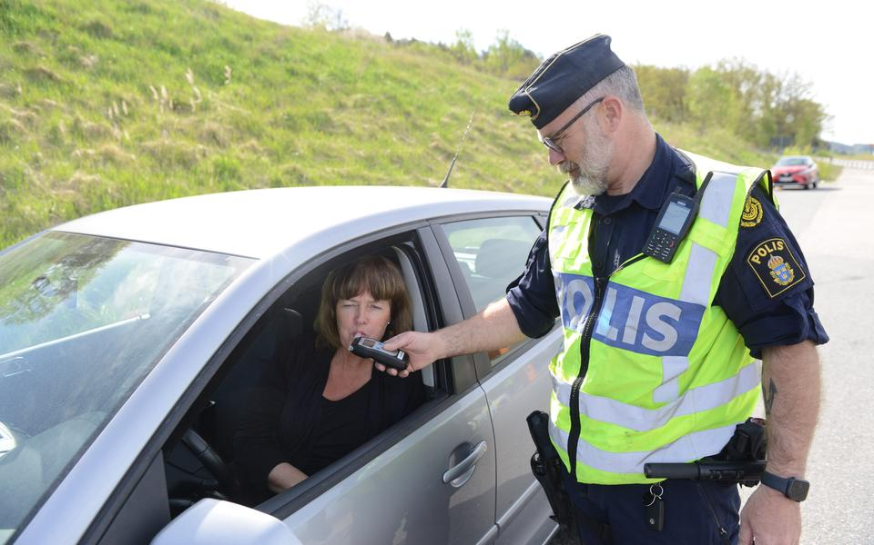
Surveillance

Slide 22
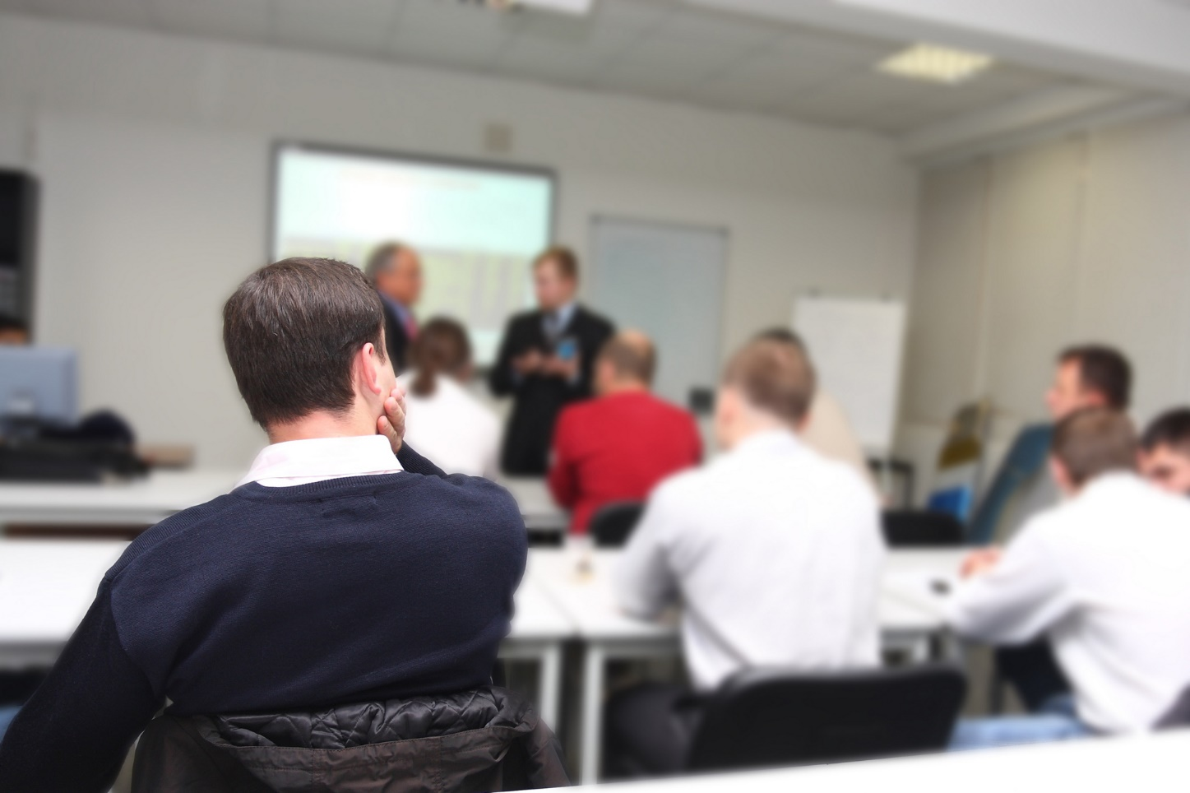

Capacity building
Notes:
Material till skola

Slide 23
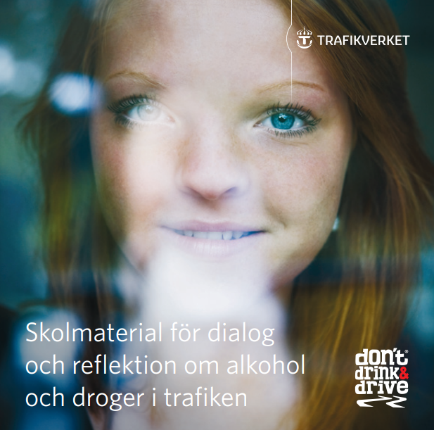
School material

Slide 24

Collaboration
Notes:
ANDT program

Slide 25






















22 authorities
Notes:
22 authorities

Slide 26

Research
Notes:
Cyklister

Slide 27
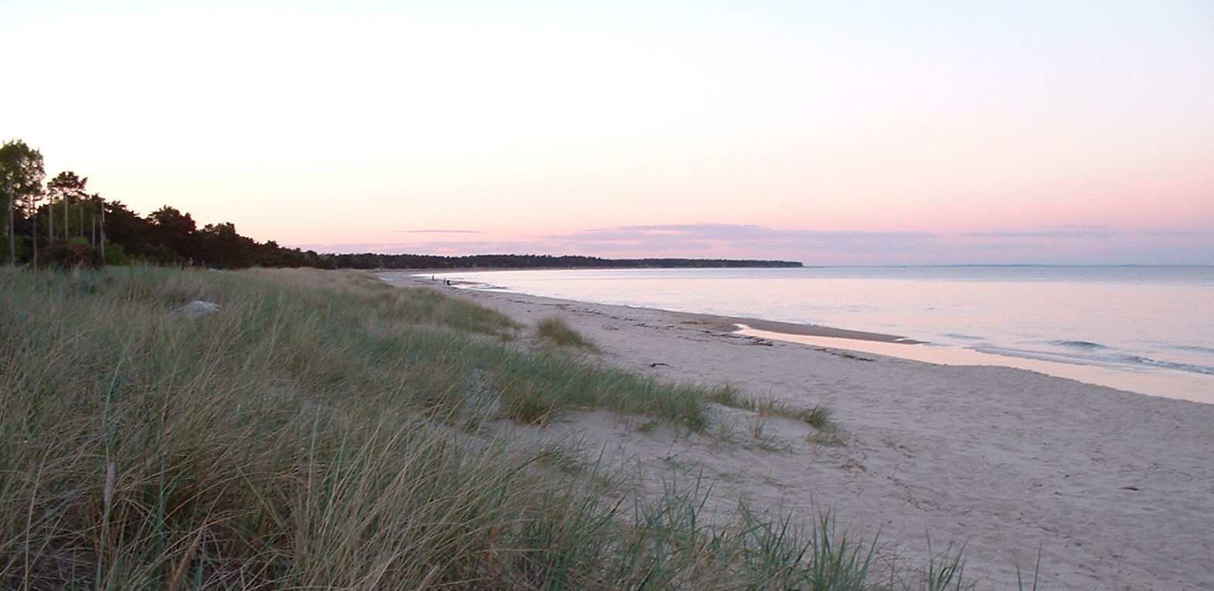

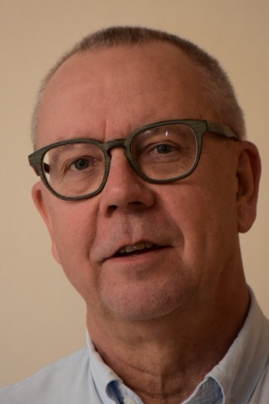
Dr Lars Ekman
Lars.Ekman@gyvik.se
Thanks
Vision Zero Academy

