Slide 1
Drink - driving in Norway
Grete Mathisrud
ETSC Safe and Sober event, 3 November 2025, Athen

Slide 2
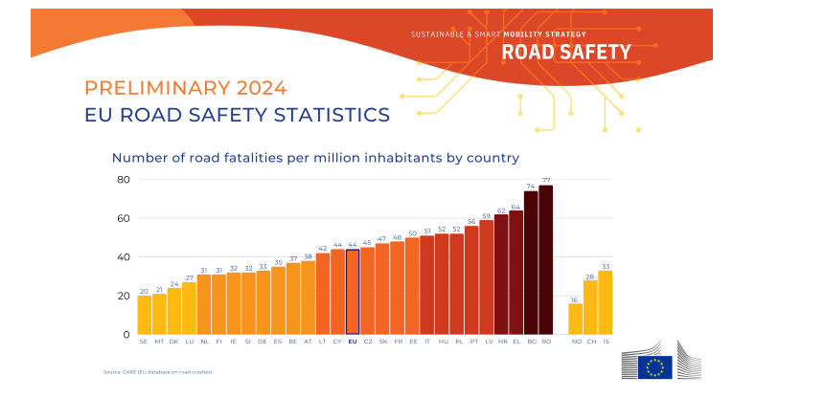
Source: CARE (EU database on road crashes)

Slide 3
Drink-driving in Norway
Driving under the influence of alcohol or drugs (DUI) is a significant traffic safety issue.
Norway applies a regulatory approach: clear rules and consistent enforcement
Daily Impact: Approximately 140,000 trips involve a driver under the influence
Long-term Impact: A contributing factor in 23% of fatal accidents over the past decade

Slide 4
Driving under the influence in
Fatal Accidents - 2024
DUI Contribution to Fatalities
29% of fatal accidents in 2024 involved impairment due to alcohol, drugs or medication
Combined Risk Behaviors
60% of DUI cases also involved speeding and not using seatbelts
Seasonal Pattern
Half of the DUI-related fatalities occurred during summer

Slide 5
Enforcement Levels
Key Measures:
Vision Zero: Shared responsibility
Public Acceptance: Support for low blood alcohol limits.
Strict Limits: For alcohol and drugs.
Regular Checks: Frequent and consistent enforcement.
Effective Sanctions: Strong penalties for offenders.

Slide 6
Police Enforcement Efforts
Routine Testing: Mandatory DUI tests during all roadside police checks.
Saliva Testers: Used to detect substances other than alcohol.
Criminal Case Handling: Extensive enforcement efforts, swift investigations, and adequate sanctions and penalties are essential.

Slide 7
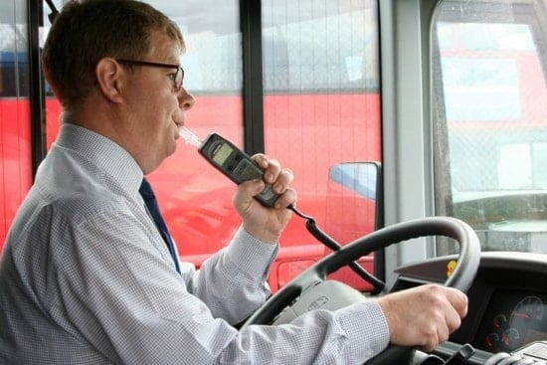
Mandatory use of Alcohol Interlock Devices in Public Transport
Illustrasjonsfoto Foto: Volvo Buses

Slide 8
Mandatory Alcohol Interlocks in Public Transport
Mandatory:
Effective from January 1, 2019, for new buses and minibuses (categories M2 and M3)
Objective:
To increase passenger safety
Exemptions:
Does not apply to foreign buses, taxis, or freight transport
Scope: National regulation applicable only to domestic traffic

Slide 9
Norwegian Regulations on Alcohol Interlocks
Legal Provision:
  The Road Traffic Act - Section 18
  Regulated by the Norwegian Public Roads Administration (NPRA)
Service Centers:
  Qualified personnel for installation and compliance with installation procedures
Costs:
  Estimated total cost: NOK 40 000 (€3,436) – includes installation, service, and dismantling
Inspections and Compliance:
  Conducted by NPRA or the Police
  Sanctions for non-compliance

Slide 10
Future Programs
No current alcohol interlock offender programs in Norway
Advocating alcohol interlock programs as an alternative to license withdrawal
The new Directive on Driving Licenses
Introduces a new approach to alcohol dependency

Slide 11
Future Road Safety Initiatives
Ongoing measures and new initiatives:
  The National Road Safety Action Plan 2026-2029, comprising 177 measures, is currently under public consultation.
Legislative proposals:
  Stricter rules and vehicle confiscation for high-level DUI offenders and extreme speeding
  Proposed ban on warning services that undermine police controls
  Strengthened legislation regarding mobile phone use while driving

Slide 12
Thank you for your attention
Grete Mathisrud

