Slide 1


DRINK DRIVING IN THE EUROPEAN UNION
Safe and Sober Poland| Warsaw, 23 January 2025
Antonio Avenoso, ETSC Executive Director

Slide 2


ETSC
A science based approach to road safety
Secretariat in Brussels
60 member organisations from across
Europe:
More than 200 experts contributing to
ETSC’s work
The European Commission, Member
Organisations, Member States and
corporate sponsors are funding our work

Slide 3
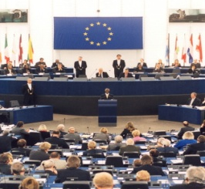






Road Safety Performance Index (PIN)
Ranking EU countries‘ performances
Monitoring EU transport
safety policy
DRUG DRIVING
Notes:
At the same time, we try to advance policy through different projects dealing with various aspects of road safety.
This goes from drink and drug driving, to vehicle safety, to education and exchange of best practice, young users and so on.
LEARN! - The project’s primary aim is to improve the quality of traffic safety and mobility education in Europe by creating a manual for experts containing best practice guidelines for designing, testing, implementing and evaluating educational measures.
SMART - The objective of the SMART project is to address the main issues related to alcohol and driving and continue ETSC advocacy activities both at EU and Member State level to tackle drink driving and reduce the number of alcohol-related deaths. This focus is aligned with the EU’s own strategy to reduce injuries and deaths caused by drink driving.
Safe and Sober - The objective of the Safe and Sober campaign is to raise awareness amongst policy makers, the private sector and key opinion leaders of the need for a systemic approach to reducing alcohol misuse in road transport, especially in poorly-performing EU member states. The project is based around a series of national events in key countries with high levels of drink driving. The events bring together senior policymakers, ETSC partners, relevant business people, safety groups, police and the press.

Slide 4
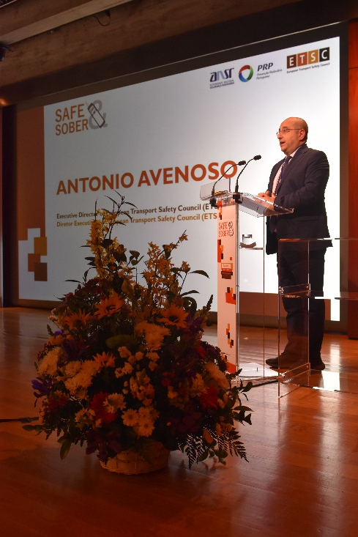

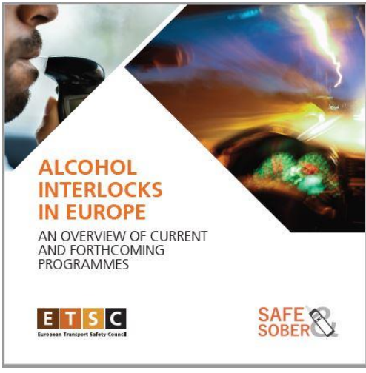
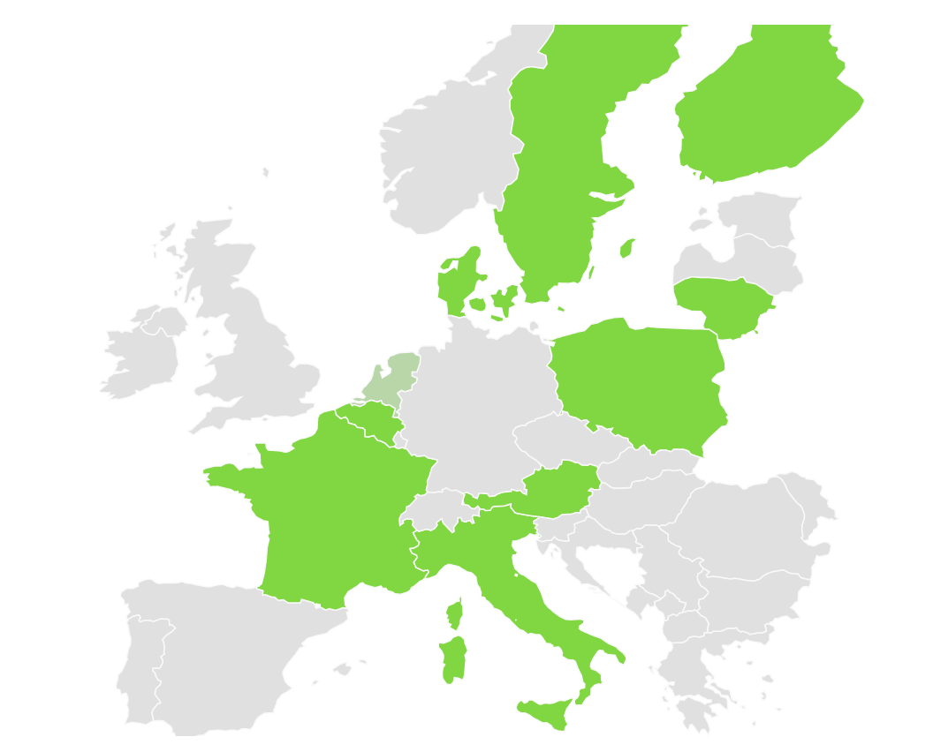
ETSC
17 years of raising awareness on Alcohol Interlocks through:
33 national events since 2008 (21 countries in Europe covered)
2 EU events in the European Parliament
Regular participation in the Alcohol Interlock Symposium
1 report on Alcohol Interlock programmes in the EU
1 EU map on updated info on AI offender programmes in the EU

Slide 5
20,418
people died in road traffic in the EU in 2023
Notes:
19,823 people lost their lives in road traffic in the EU in 2021
9,042 fewer than in 2011

Slide 6
2,260
people died in alcohol-related crashes in 2021*
*in 23 EU countries

Slide 7
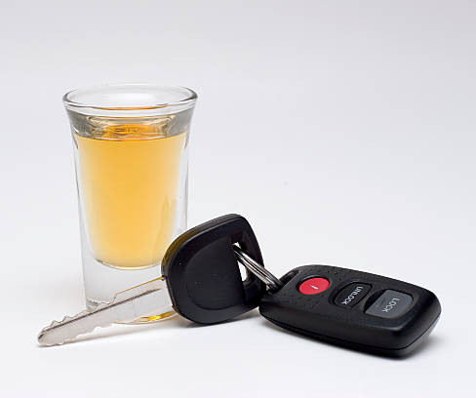
DRINK-DRIVING IN THE EUROPEAN UNION
Up to 1.5 - 2% of KM driven in the EU are driven with an illegal Blood Alcohol Concentration (BAC);
Of all road deaths in the EU, 25% are alcohol-related;
Risk factor in up to 40% of e-scooter deaths
Alcohol related crashes are the leading cause of death in the age group 16-25
Notes:
.
While the dangers linked to drink driving are fairly well understood, the phenomenon is still widespread in the EU:

Slide 8
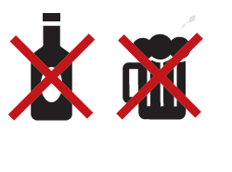
DRINK-DRIVING IN THE EUROPEAN UNION
At least 4,000 deaths could have been prevented by eliminating drink driving
Notes:
.
While the dangers linked to drink driving are fairly well understood, the phenomenon is still widespread in the EU:

Slide 9
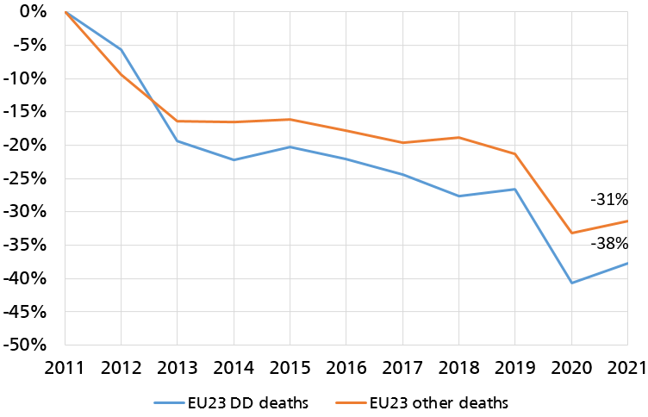
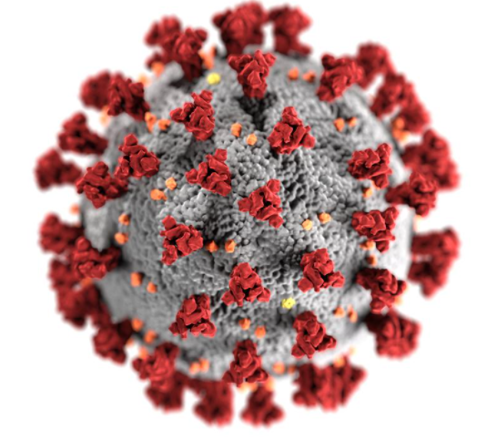
DRINK DRIVING PROGRESS 2011-2021
Notes:
The EU27 collectively reduced the number of road deaths by 31% over the period 2011-2021
There were 57,095 fewer deaths on EU roads over the last decade than there would have been if deaths had continued at the same level as in 2011
The overall progress in reducing road deaths on EU roads was positive from 2011 until 2014 with a 16% decrease.
But the good start was followed by five consecutive years of stagnation with only a 7% reduction over the 2015-2019 period. In 2020 there was an exceptional drop of 17% compared to 2019.
2021 also saw a consistent drop of 13% with respect to 2019, but the number of road deaths increased by 5% with respect to 2020, influenced by a gradual relaxation of travel restrictions across Europe.
The exceptional 2020 and 2021 results were largely a consequence of Covid-19 lockdowns and associated measures. There is no guarantee that this progress can be maintained under a return to business as usual.

Slide 10
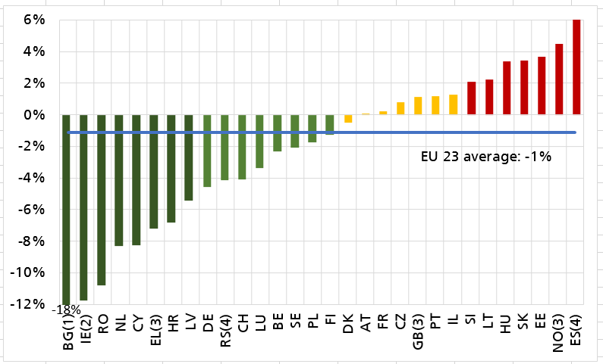
PROGRESS IN TACKLING DRINK DRIVING 2011 – 2021
Difference between the average annual percentage change in deaths attributed to drink driving and corresponding change in other road deaths
Bulgaria -18%
Romania -11%
The Netherlands -8%
Norway 4.5%
Estonia 3.6%
Slovakia 3.4%
Notes:
PT -3%

Slide 11
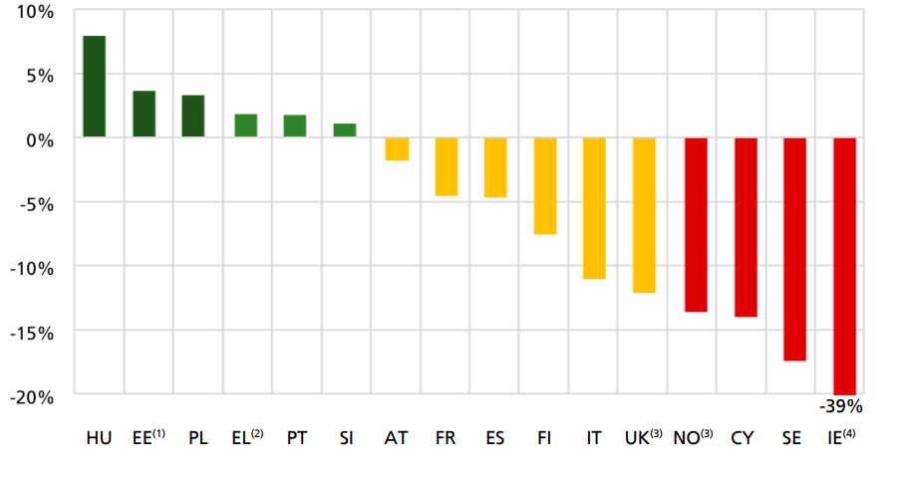

Drink-driving – alcohol breath checks (2011-2021)
Average annual change in the number of alcohol roadside breath checks per 1000 population over the period 2011-2021

Slide 12
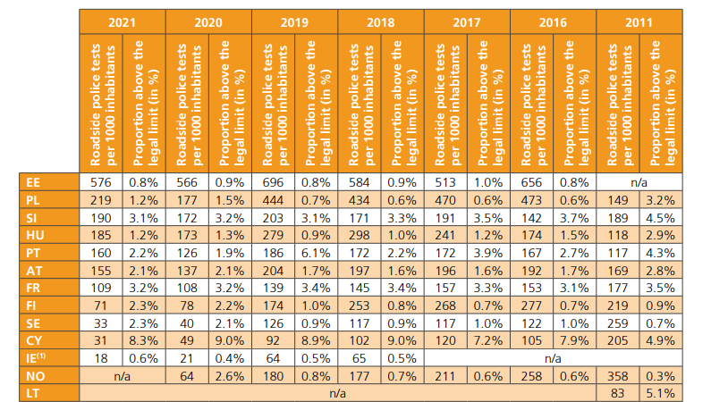
Drink-driving – alcohol breath checks (2011-2021)
Notes:
Estonia was the most active in 2019 with 696 checks carried out per 1000 population whereas Alcohol checks were relatively infrequent in Ireland (64 per 1000 population).
Roadside checks are not comparable between countries because of aspects such as randomness, the place and time of checks.

Slide 13




EFFECTIVE MEASURES
Lower Blood Alcohol Concentration (BAC) limits;
Sanctions and enforcement;
Alcohol Interlocks (rehabilitation and commercial transport);
Education and campaigns
Notes:
.
While the dangers linked to drink driving are fairly well understood, the phenomenon is still widespread in the EU:

Slide 14
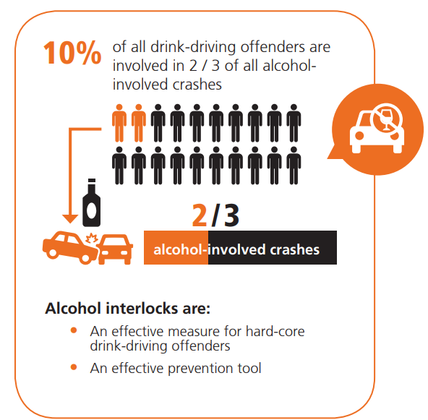
ALCOHOL INTERLOCKS & REHABILITATION PROGRAMMES
LEGISLATION NEEDED
To maximise the effect on road safety,
alcohol interlock programmes for drink-driving offenders should be compulsory
and placed under administrative law.

Slide 15



STRENGHTS AND WEAKNESSES
Effective programmes showed positive impacts such as:
a) securing the jobs of people who relied on being able
to drive for work;
b) making drivers aware of their responsibilities;
c) helping offenders remain integrated in society (although participation is sometimes perceived as a constraint);
B. Two key elements for a successful programme:
Rehabilitation measures
Affordable costs

Slide 16
ALCOHOL INTERLOCK BAROMETER 2008
Voluntary basis
Pilot project
Legislation in discussion
Legislation in force

Slide 17
ALCOHOL INTERLOCK BAROMETER 2016
Voluntary basis
Pilot project
Legislation in discussion
Legislation in force

Slide 18
ALCOHOL INTERLOCK BAROMETER 2024
Voluntary basis
Pilot project
Legislation in discussion
Legislation in force
Notes:
Spain will require all new types of M2 and M3 vehicle, i.e. mini-buses designed to carry more than eight people, buses and coaches, to be fitted with an alcohol interlock device from next year.

Slide 19
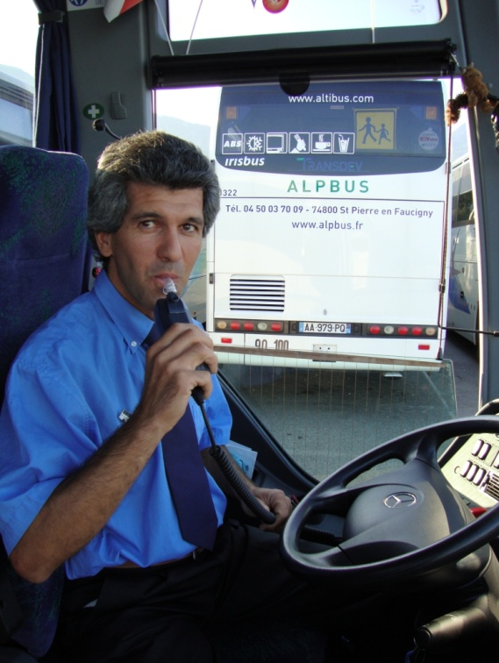
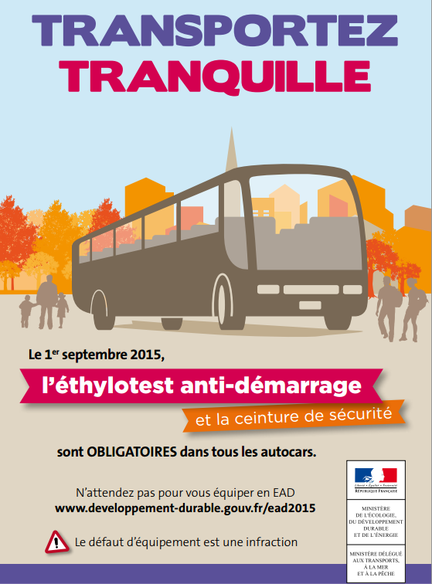
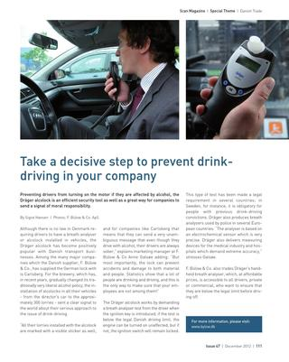
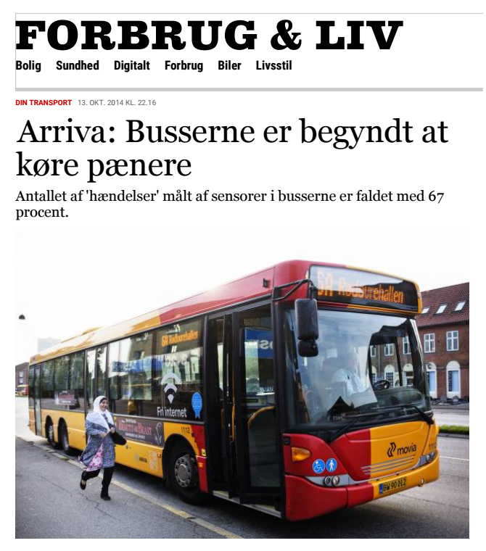
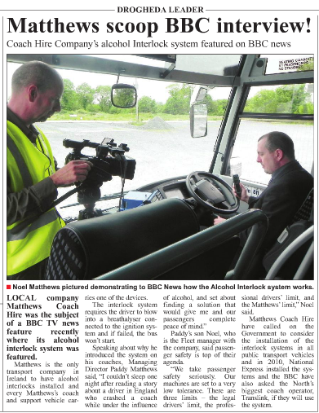
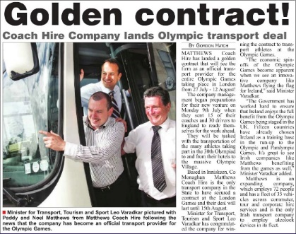
ALCOHOL INTERLOCKS IN COMMERCIAL TRANSPORT
In commercial vehicles as an extension of the vehicle safety systems and demonstrate the company’s commitment to both driver and public safety.

Slide 20
OUR RECOMMENDATIONS
Mandate the use of alcohol interlocks for professional drivers
As a first step towards wider use of alcohol interlocks, legislate their use for repeat offenders and professional drivers
Develop use of alcohol interlocks as part of rehabilitation programmes
Allow people with an alcohol dependency to be included in alcohol interlock rehabilitation programmes, as long as it is combined with medical supervision

Slide 21

SAFE AND SOBER – LATEST VIDEO CAMPAIGN

Slide 22
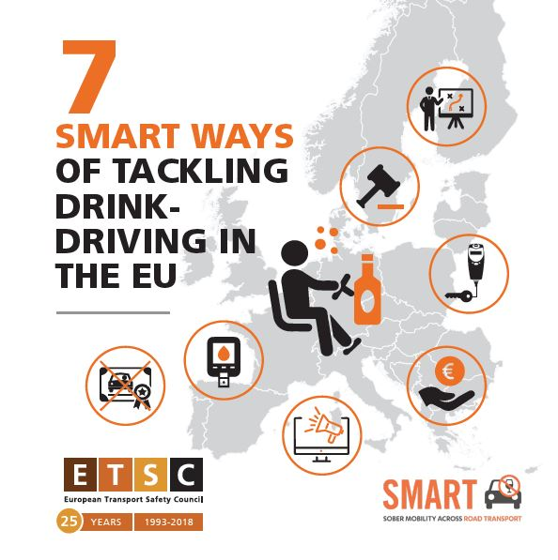
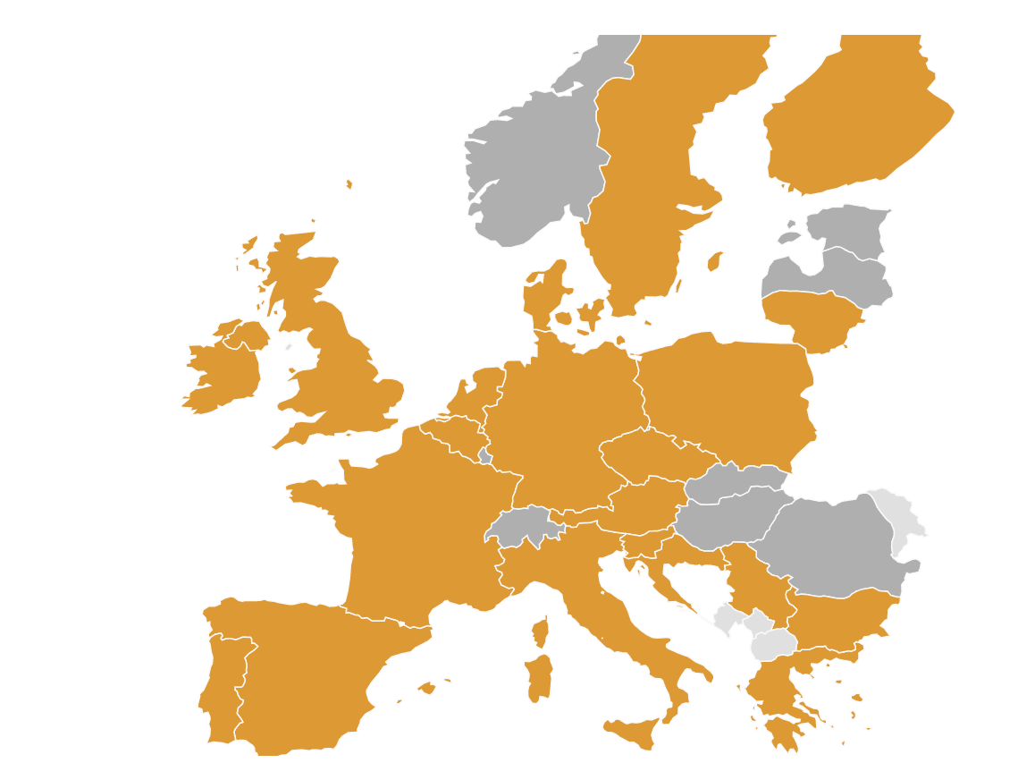

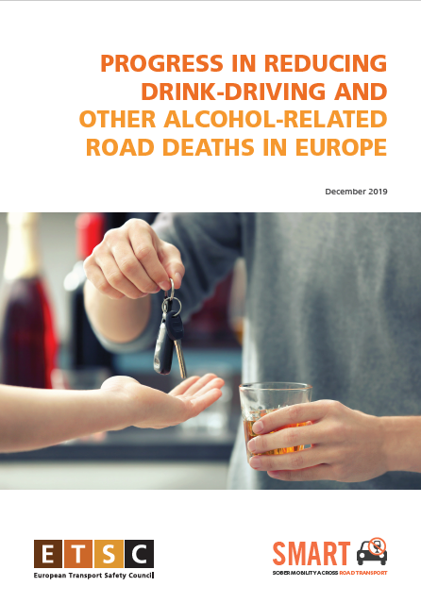
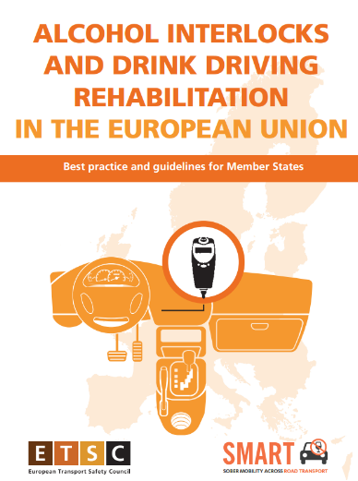

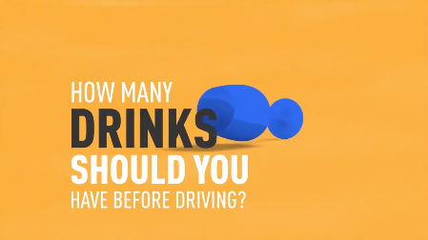
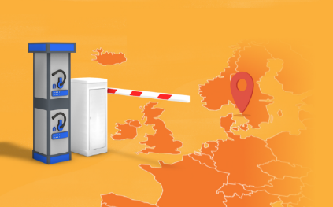
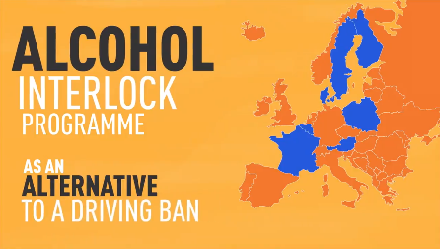
FIND OUT MORE
www.etsc.eu
@etsc_eu
Thank you for your attention!
Find out more
Interactive map on drink-driving policies online
Watch our Videos

