Slide 1


DRINK DRIVING AND ALCOHOL INTERLOCKS IN EUROPE
Safe and Sober Prague| 30 June 2026
Francesca Podda, Project Manager

Slide 2


ETSC
A science based approach to road safety
Secretariat in Brussels
61 member organisations from across Europe:
More than 200 experts contributing to ETSC’s work
The European Commission, Member Organisations, Member States and corporate sponsors are funding our work

Slide 3
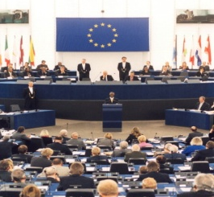




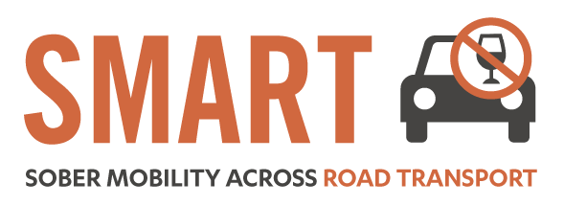

Road Safety Performance Index (PIN)
Ranking EU countries‘ performances
Monitoring EU transport
safety policy
DRUG DRIVING
Notes:
At the same time, we try to advance policy through different projects dealing with various aspects of road safety.
This goes from drink and drug driving, to vehicle safety, to education and exchange of best practice, young users and so on.
LEARN! - The project’s primary aim is to improve the quality of traffic safety and mobility education in Europe by creating a manual for experts containing best practice guidelines for designing, testing, implementing and evaluating educational measures.
SMART - The objective of the SMART project is to address the main issues related to alcohol and driving and continue ETSC advocacy activities both at EU and Member State level to tackle drink driving and reduce the number of alcohol-related deaths. This focus is aligned with the EU’s own strategy to reduce injuries and deaths caused by drink driving.
Safe and Sober - The objective of the Safe and Sober campaign is to raise awareness amongst policy makers, the private sector and key opinion leaders of the need for a systemic approach to reducing alcohol misuse in road transport, especially in poorly-performing EU member states. The project is based around a series of national events in key countries with high levels of drink driving. The events bring together senior policymakers, ETSC partners, relevant business people, safety groups, police and the press.

Slide 4
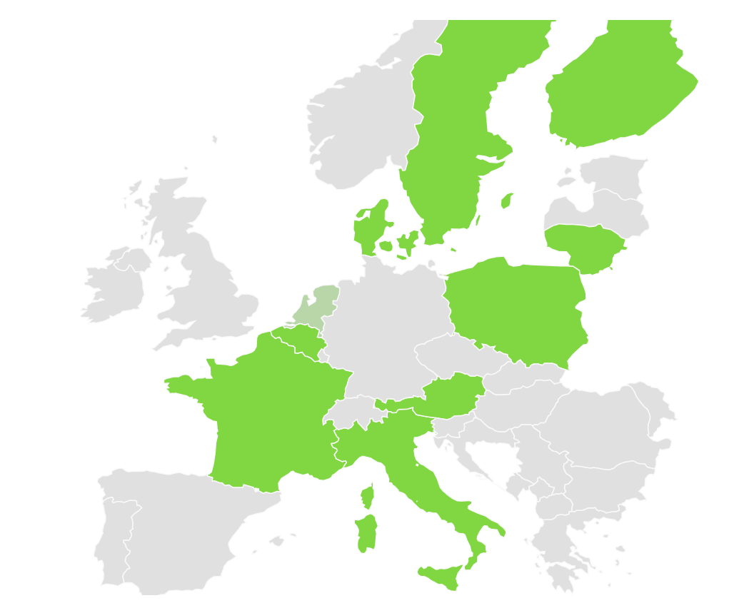
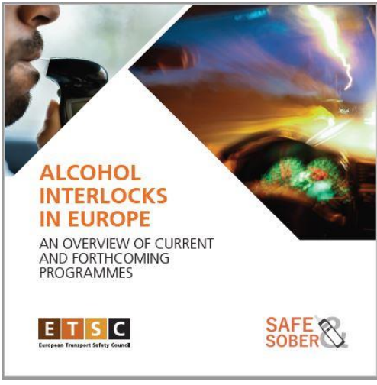

SAFE AND SOBER
National events in EU countries (35 completed since 2008)
Alcohol Interlocks map online;
An inventory of alcohol interlock programmes in Europe
Video sharing two participants’ experience in Belgium’s alcohol interlock rehabilitation programme (launched in January 2023).

Slide 5
19,492
people died in road traffic in the EU in 2025

Slide 6
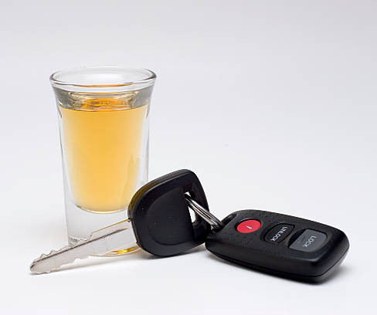
DRINK-DRIVING IN THE EUROPEAN UNION
Up to 1.5 - 2% of KM driven in the EU are driven with an illegal Blood Alcohol Concentration (BAC);
Of all road deaths in the EU, 25% are alcohol-related;
Risk factor in up to 40% of e-scooter deaths
Alcohol related crashes are the leading cause of death in the age group 16-25
Notes:
.
While the dangers linked to drink driving are fairly well understood, the phenomenon is still widespread in the EU:

Slide 7
2,234
people died in alcohol-related crashes in 2024*
*in 22 EU countries

Slide 8
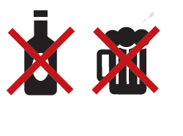
DRINK-DRIVING IN THE EUROPEAN UNION
At least 4,000 deaths could have been prevented by eliminating drink driving
Notes:
.
While the dangers linked to drink driving are fairly well understood, the phenomenon is still widespread in the EU:

Slide 9
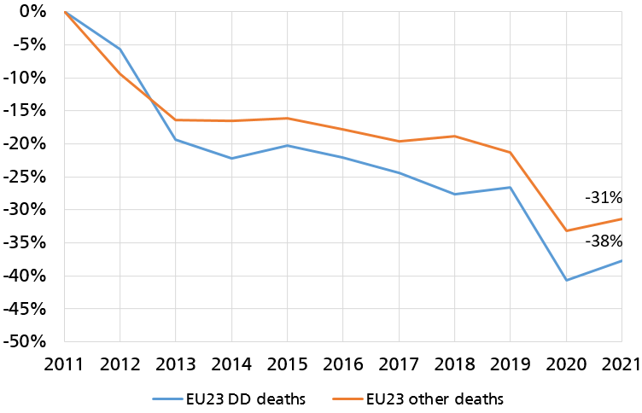
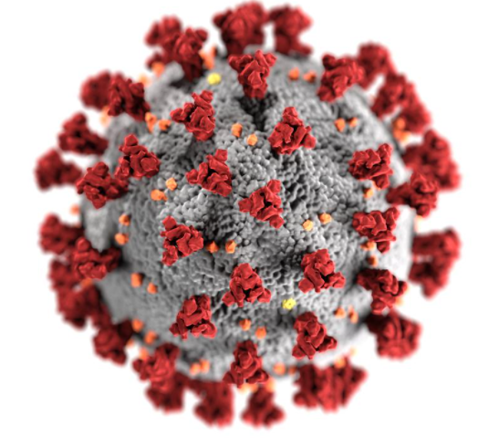
DRINK DRIVING PROGRESS 2011-2021
Notes:
The EU27 collectively reduced the number of road deaths by 31% over the period 2011-2021
There were 57,095 fewer deaths on EU roads over the last decade than there would have been if deaths had continued at the same level as in 2011
The overall progress in reducing road deaths on EU roads was positive from 2011 until 2014 with a 16% decrease.
But the good start was followed by five consecutive years of stagnation with only a 7% reduction over the 2015-2019 period. In 2020 there was an exceptional drop of 17% compared to 2019.
2021 also saw a consistent drop of 13% with respect to 2019, but the number of road deaths increased by 5% with respect to 2020, influenced by a gradual relaxation of travel restrictions across Europe.
The exceptional 2020 and 2021 results were largely a consequence of Covid-19 lockdowns and associated measures. There is no guarantee that this progress can be maintained under a return to business as usual.

Slide 10
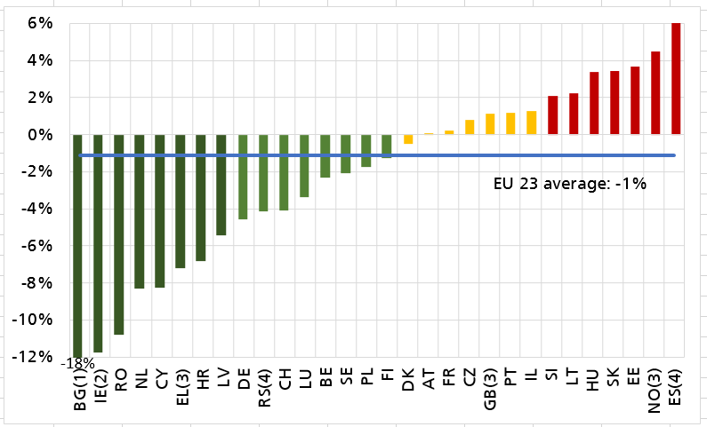
PROGRESS IN TACKLING DRINK DRIVING 2011 – 2021
Difference between the average annual percentage change in deaths attributed to drink driving and corresponding change in other road deaths
Bulgaria -18%
Romania -11%
The Netherlands -8%
Norway 4.5%
Estonia 3.6%
Slovakia 3.4%
Notes:
IE data not available
Ireland reports on road user deaths with a positive toxicology for alcohol. A positive toxicology for alcohol is recorded where the Blood Alcohol Concentration (BAC) of the deceased is >20mg alcohol per 100ml blood (or equivalent in urine). These data are collected from closed coronial files, which become available for data collection once the inquest of the road user death has been completed. This can take a number of years, particularly if there is a prosecution involved. To date, the Road Safety Authority (RSA) has coronial data for road user deaths which occurred during 2013-2019. A recent analysis of driver deaths (2014-2018; including motorcycle drivers) with a toxicology result available, found that 37% had a positive toxicology for alcohol.

Slide 11
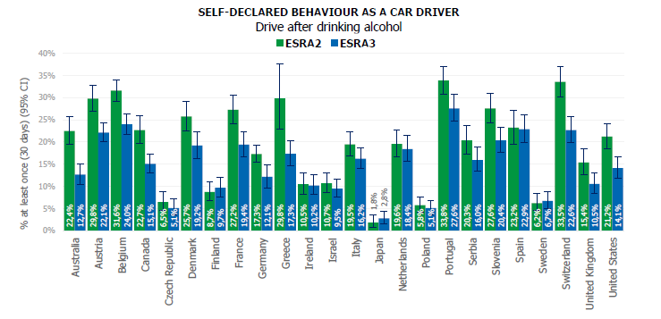
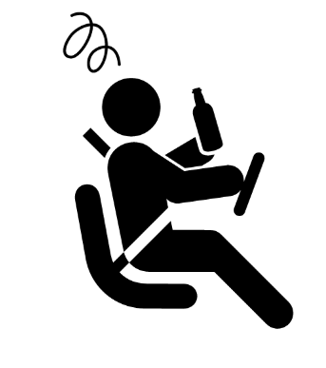
DRINK-DRIVING IN THE EUROPEAN UNION
*Source ESRA (2024)
Notes:
As for self-declared behaviour of driving a car after drinking alcohol (Figure 21 and Table 5 in Appendix 5), the percentage of car drivers who reported the behaviour decreased in 21 of the 24 ESRA countries. The differences were significant in 12 of the 21 countries where the proportion decreased. This suggests that, overall, the prevalence of driving a car after drinking alcohol decreased
It should be noted that for some countries very large differences between ESRA2 and ESRA3 were found. For example Greece (29.8% in ESRA2 to 17.3% in ESRA3).

Slide 12




EFFECTIVE MEASURES
Lower Blood Alcohol Concentration (BAC) limits;
Sanctions and enforcement;
Alcohol Interlocks (rehabilitation and commercial transport);
Education and campaigns
Notes:
.
While the dangers linked to drink driving are fairly well understood, the phenomenon is still widespread in the EU:

Slide 13
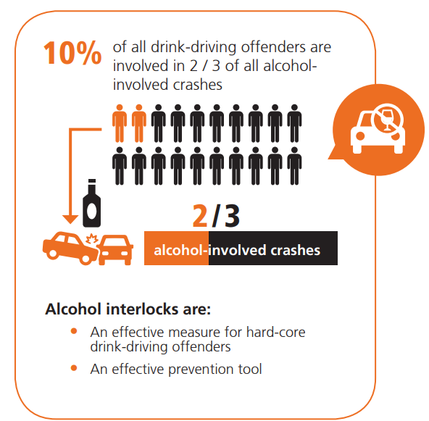
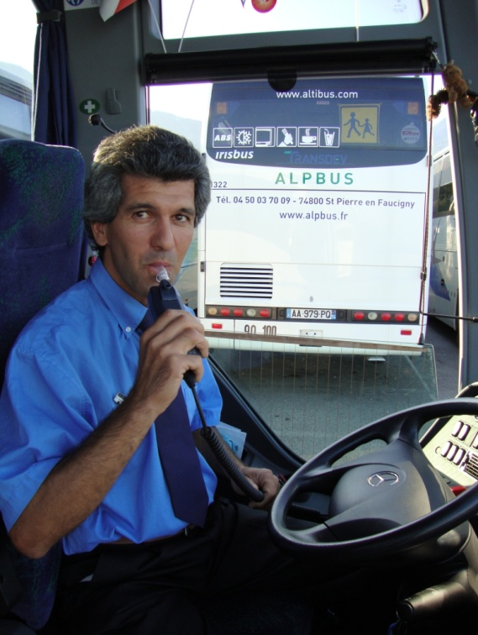
ALCOHOL INTERLOCKS
In commercial vehicles as an extension of the vehicle safety systems and demonstrate the company’s commitment to both driver and public safety.

Slide 14
ALCOHOL INTERLOCK BAROMETER 2008
Voluntary basis
Pilot project
Legislation in discussion
Legislation in force

Slide 15
ALCOHOL INTERLOCK BAROMETER 2016
Voluntary basis
Pilot project
Legislation in discussion
Legislation in force

Slide 16
ALCOHOL INTERLOCK BAROMETER 2026
Voluntary basis
Pilot project
Legislation in discussion
Legislation in force
Notes:
Spain will require all new types of M2 and M3 vehicle, i.e. mini-buses designed to carry more than eight people, buses and coaches, to be fitted with an alcohol interlock device from next year.

Slide 17



STRENGHTS AND WEAKNESSES
Effective programmes showed positive impacts such as:
a) securing the jobs of people who relied on being able
to drive for work;
b) making drivers aware of their responsibilities;
c) helping offenders remain integrated in society (although participation is sometimes perceived as a constraint);
B. Key elements for a successful programme:
Rehabilitation measures
Affordable costs
Start the programme immediately after offence

Slide 18
ETSC RECOMMENDATIONS
Mandate the use of alcohol interlocks for professional drivers
Ensure the timely adoption of the implementing legislation on alcohol interlock installation facilitation for motor vehicles
As a first step towards wider use of alcohol interlocks, legislate their use for repeat offenders and professional drivers.
Allow people with an alcohol dependency to be included in alcohol interlock rehabilitation programmes, as long as it is combined with medical supervision

Slide 19
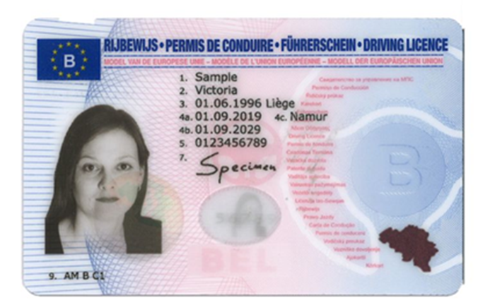
REVISION OF EU DRIVING LICENCE DIRECTIVE
- Council and European Parliament reached a deal in March 2025
Medical Fitness: overhaul of medical conditions, MSs will have to introduce medical checks & allow new use of alcohol interlocks for dependents
X Probationary period of 2 years, but no requirements e.g. 0 alcohol and drugs
Notes:
No changes so far to EC proposal for alcohol dependent drivers and AI

Slide 20
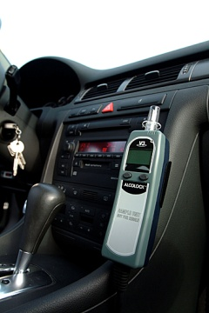
EU GENERAL SAFETY REGULATION
A standardised interface that facilitates the fitting of aftermarket alcohol interlock devices in motor vehicles required for all new type approved vehicles as of mid-2022 and all new vehicles as of mid-2024
Reference to the European standard on alcohol interlocks (EN 50436)

Slide 21

SAFE AND SOBER – LATEST VIDEO CAMPAIGN

Slide 22
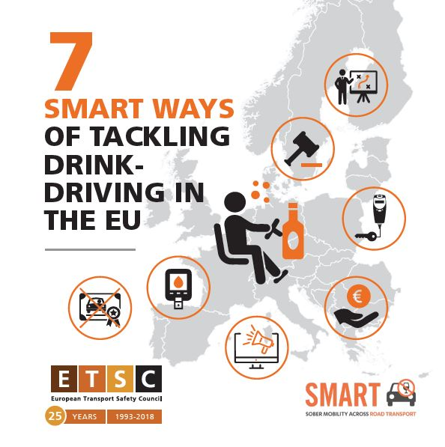

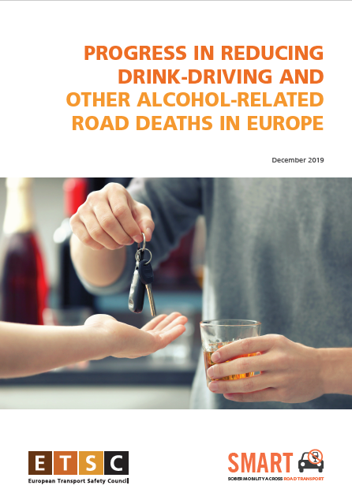
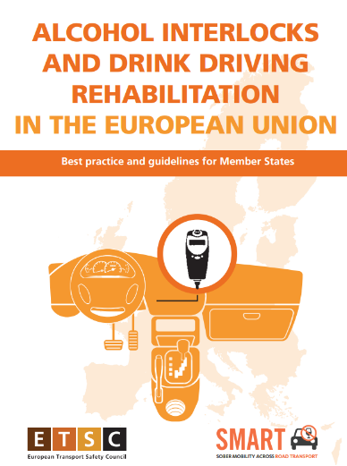

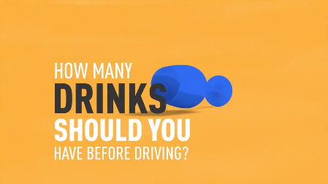
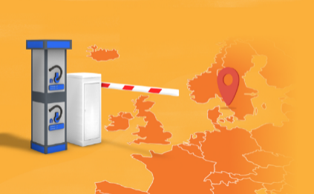
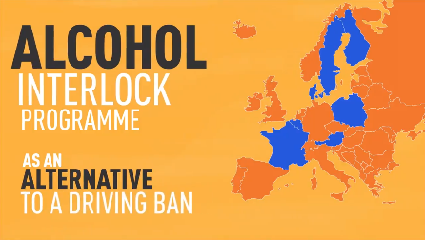
FIND OUT MORE
www.etsc.eu
@etsc_eu
Alcohol Interlocks map online
https://etsc.eu/issues/drink-driving/alcohol-interlock-barometer/
Find out more
Francesca Podda, Project Manager
Watch our Videos

