Slide 1



Safe & Sober Talk Warsaw – 23 January 2025
Alcohol Interlock legislation in Belgium

Slide 2

BE situation DUI alcohol
2023 :
4050 injury crashes involving a driver under influence of alcohol
  = 11 per day,
  average BAC = 1.7 ‰
40 % of road crashes during weekend nights are linked to alcohol or drugs
Nearly 50 000 drivers caught
5 months ‘BOB’-campaign (drinking vs. driving): summer & winter, police checks & sensibilization
→ Summer ‘BOB’ campaign 2024: 2,03% of all people checked were positive
BAC limit: 0.5 ‰, only professional drivers 0.2 ‰
→ Proposal for legislation pending in parliament: lower limit to 0.2 ‰; zero tolerance)
Notes:
The situation is not so bright…
Weekend nights: it is precisely at these high-risk times that far too few checks are made.

Slide 3
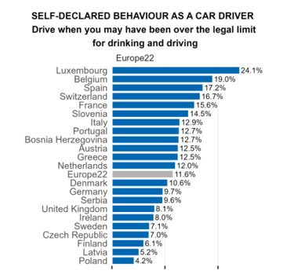
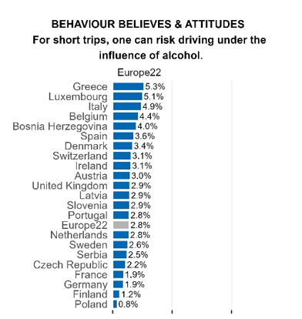
ESRA3 Thematic report Nr. 10 (E-Survey of Road users’ Attitudes): Meesmann, U., Pires, C., Wardenier, N. (2024). Driving under the influence of alcohol, drugs or medication. Vias institute.
Notes:
You will see that Poland and Belgium are often extremes on the European scale, with Poland being the good student and Belgium the bad student of the class.

Slide 4
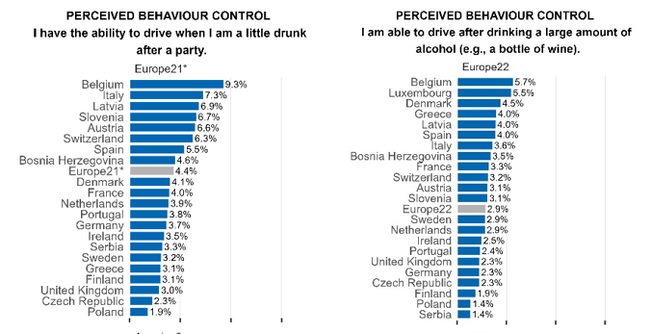
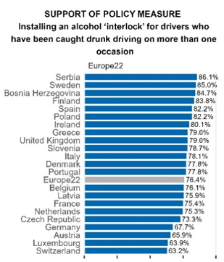
ESRA3 Thematic report (E-Survey of Road users’ Attitudes)

Slide 5

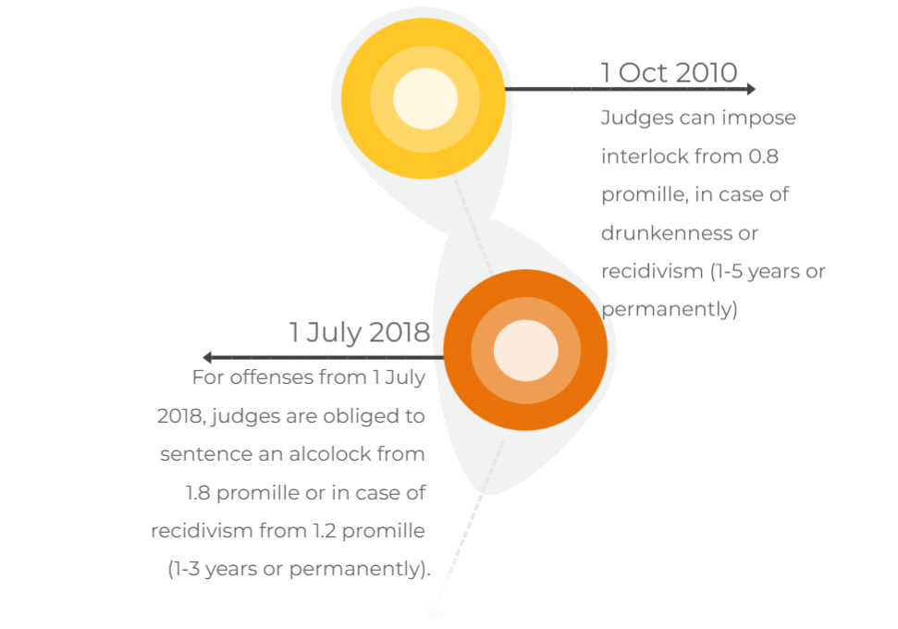

Alcohol Interlock legislation in BE
BE legislative history
Law of 12/07/2009 and royal decrees of 26/11/2010
Law 6/03/2018

Slide 6
Targeted offenders
Judge MUST impose
- severe intoxication (≥1.8 pm)
unless properly motivated
- ≥1.2 pm for repeat offenders no exception possible
= 1 – 3 years/ for life
Judge MAY impose
- intoxication ≥ 0.8 pm
- drunkenness
- slight recidivism
AI for
heavy drink-drivers
The judge can exempt certain vehicle categories (e.g. bus/truck) from AI,
except the category of offense
Out of scope: alcohol addiction (driving ban); driving ban for life

Slide 7
Number of AI for offenders
2009-10: 1st legislation
2013: 1st device installed
2014: 7 offenders convicted
until 2017: only 66 persons in AI monitoring program
2018: 2nd legislation
2019: 165 installations (>2900 convictions)
2020: 600 installations (>3800 convictions)
2021: 860 installations
2022: 960 installations
until end 2022: > 2600 ongoing programs
2023: > 1000 installations
2024: 1282 installations (2518 running programs)
Notes:
it seemed a real flop
the cape of 1,000 installations was crossed

Slide 8



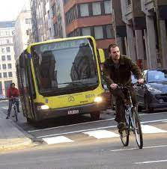



Notification of the judgment by public prosecutor to convicted person: choice to make
No AI
No more driving
during same period
2. Alcohol Interlock

Slide 9

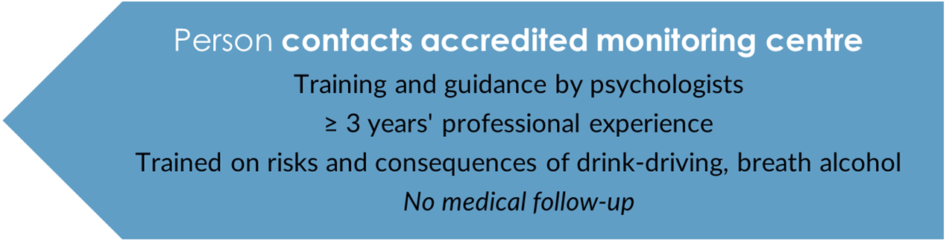



Monitoring program: a roadmap (1/3)
Notification of the judgment by
public prosecutor
Notes:
constitution and breakdown of breath alcohol
circumventing the system (e.g. having someone else blow and subsequently test positive again, or drink-driving)

Slide 10


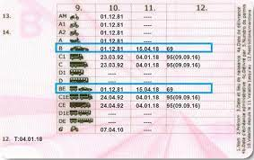




Monitoring program: a roadmap (2/3)
Installation of the device in accredited service centre
- within 30 days

Slide 11



Monitoring program: a roadmap (3/3)
Periodic downloads of registration unit by service centre every 2 months (after 1 year every 6 months).
Data stored on a secured place and only readable by monitoring centre
Every time an evaluation of these data by monitoring centre. Whenever necessary and at least twice a year:
individual guidance interview
Closing meeting
Removal of the device

Slide 12
Conditions to fulfill during monitoring program
pay costs in time
duly participate in the program
not drink drive anymore (≤ 0.2 BAC)
not too often try to start under influence
not disconnect or circumvent the system (abnormal results)
if not: program comes to early end & monitoring centre notifies public prosecutor in detail
public prosecutor can summon before court (judge: imprisonment, driving ban, fine)
Notes:
negative initial test followed by positive retest

Slide 13
Consequences of conviction
1
2
3
4
Device
Monitoring program
Driving ban
(+ tests)
Fine
Min. €1 600
Min. € 3 200 for repeat offense
1 year: € 1 200
3 years: € 1 700
1 year: € 2 250
3 years: € 4 100
Theory test
Practical test
Psych eval
Medical test
Judge can allow deduction of the costs from the fine

Slide 14


Costs
1 year: € 3500
3 years: € 6000
65 – 70% device and downloads
30 – 35% monitoring program
How to lower the huge costs?
Judges can allow deduction of the costs from the fine
Monitoring program: pay by instalments
Device to rent (30%)/ purchase (70%)
Open market for monitoring centres, service centres and model-approved devices
Second hand market
2
3
Device
Monitoring program
Driving ban
(+ tests)
1 year: € 1 200
3 years: € 1 700
1 year: € 2 250
3 years: € 4 100
Theory test
Practical test
Psych eval
Medical test

Slide 15
Our good strategies
Convince and push judges
Monitoring program
Several AI manufacturers: lower prices, different accents like allow rental
Territorial coverage of service centres (2: 33) and monitoring centres (4: 74)
A program of 5 years is too long; 1-3 years can cause positive behavorial changes
Keep device after the AI period - helps keeping up good habits (without program)
Threshold at 0.2 pm (zero tolerance)
Annual verification of device by an accredited body (independency)
2
3
Device
Monitoring program
Driving ban
(+ tests)
1 year: € 1 200
3 years: € 1 700
1 year: € 2 250
3 years: € 4 100
Theory test
Practical test
Psych eval
Medical test
Notes:
3 models approved

Slide 16


Our issues
- Time gap between offence and sanction: 12 to 18 months
- Alcohol dependency or not (driving ban for incapacity versus AI)?
No standard medical check
- Judges often opt out if they can
- Retests while driving to counter circumvention (retest is to be completed within 15’)
- Combination driving ban (+ tests) + AI = complex
Subsequent decisions may need proper arrangements with public prosecutor
2
3
Device
Monitoring program
Driving ban
(+ tests)
1 year: € 1 200
3 years: € 1 700
1 year: € 2 250
3 years: € 4 100
Theory test
Practical test
Psych eval
Medical test

Slide 17
Alcohol interlocks: win – win
Safe roads
After AI period: some studies show behaviour change if monitored
Possibility to keep on driving (social & professional life)
During AI period: chance on drink driving - 75%
Monitoring program helps for lasting behaviour change
2
3
Device
Monitoring program
Driving ban
(+ tests)
1 year: € 1 200
3 years: € 1 700
1 year: € 2 250
3 years: € 4 100
Theory test
Practical test
Psych eval
Medical test
Video ETSC: "It has changed my life..." - How alcohol interlocks can save lives and change lives - YouTube

Slide 18


anneliese.heeren@mobilit.fgov.be
FPS Mobility and Transport
Thank you for your attention!

