Slide 1
Drink-driving in Norway
Grete Mathisrud
Budapest – 13 May 2025

Slide 2
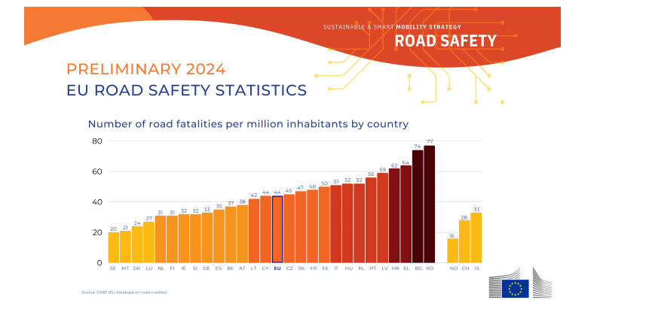
Source: CARE (EU database on road crashes)

Slide 3
Drink-driving situation in Norway
Driving under the influence of alcohol or drugs (DUI)
is a significant traffic safety issue in Norway.
Daily Impact: 140,000 trips with DUI driver
Long-term Impact: contributing factor in 25% of fatal accidents over the past decade

Slide 4
Levels of enforcement
Key Measures:
Vision Zero: Shared responsibility
Public Acceptance: Support for low blood alcohol limits.
Strict Limits: For alcohol and drugs.
Regular Checks: Frequent and determined.
Effective Sanctions: Strong penalties for offenders.

Slide 5
Police Efforts
Routine Testing: Mandatory DUI tests during all roadside police control.
Saliva Testers: Detect substances other than alcohol.
Criminal Case Handling: Extensive control efforts, quick investigations and adequate sanctions and penalties are key.

Slide 6
Mandatory use of Alcohol Interlock in public transport
Mandatory: Effective from January 1, 2019, for new buses and minibuses (M2 and M3)
Objective: Aims to increase passenger safety
Exemptions: Does not apply to foreign buses, taxis, or freight transport
National regulation applicable only to domestic traffic

Slide 7
Alcohol Interlock Regulations in Norway
Legal Provision:
  The Road Traffic Act - Section 18
  Regulated by the Norwegian Public Roads Administration (NPRA)
Service Centers:
  Qualified personnel for installation, compliance with installation procedures
Costs:
  Estimated total cost: NOK 40 000 (€3,360) – installation, service and dismantling
Inspections and Compliance:
  NPRA or Police
  Sanctions for non-compliance

Slide 8
Future Programs
No current alcohol interlock offender programs in Norway
Advocacy for alcohol interlock programs as an alternative to license withdrawal
European Commission proposal for driving licenses with alcohol interlock condition
Norway supports the proposal for flexibility in rehabilitation and traffic safety
Awaiting national assessment and EU directive adoption

Slide 9
Future Road Safety Initiatives
Ongoing Measures and new Initiatives
Government Efforts:
  Increased controls and enforcement
  Infrastructure improvements on critical road segments
Legislative Proposals:
  Stricter rules on vehicle confiscation for high-level DUI offenders and extreme speeding
  Prohibition of warning services that undermine police controls

