Slide 1



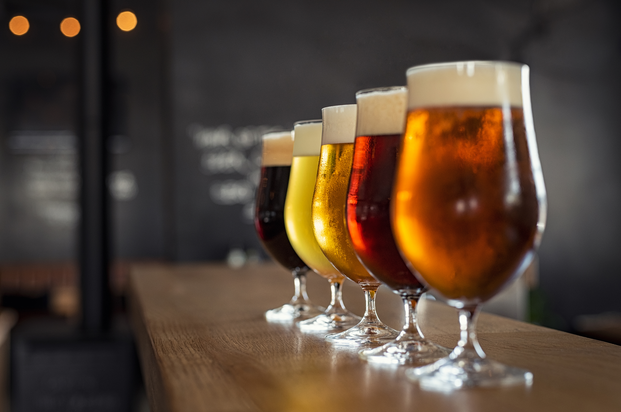

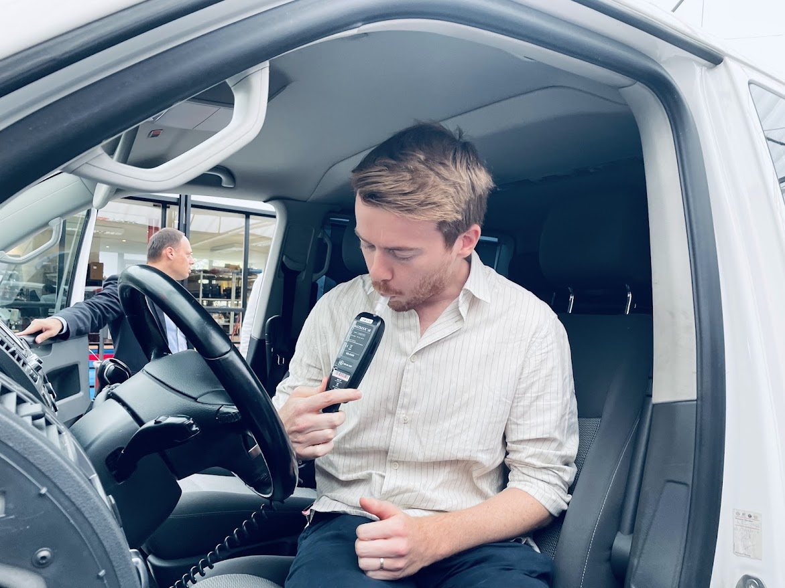
Safe & Sober Talk Budapest – 13 May 2025
Alcohol Interlock legislation in Belgium
Notes:
the topic of beer brings me seamlessly to today's topic.

Slide 2
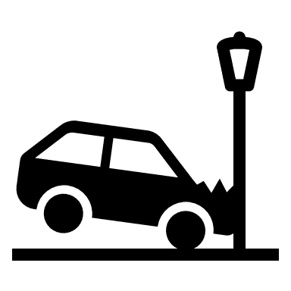
BE situation DUI alcohol
BAC limit: 0.5, professional drivers 0.2 ‰
  Several attempts to lower threshold for all drivers…
2023 :
  50 000 drivers caught for DUI
  After an injury crash, > 10 % of drivers test positive
  40 % of road crashes during weekend nights are linked to DUI
  4050 injury crashes involving a driver under influence of alcohol
  = 11 per day
  average BAC = 1.7 ‰
Notes:
The situation is not so bright…
Weekend nights: it is precisely at these high-risk times that far too few checks are made.

Slide 3

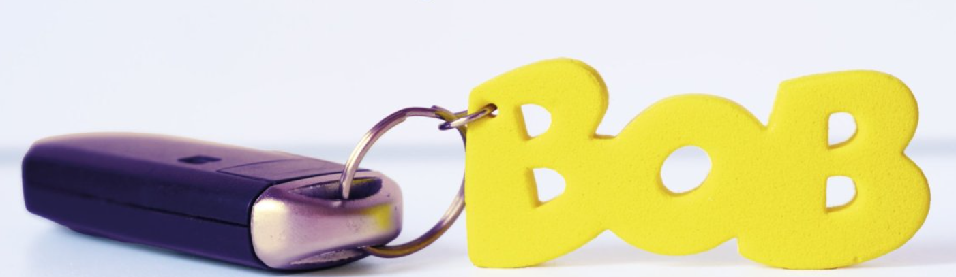
BE situation DUI alcohol
‘BOB’-campaign: drinking vs. driving
Police checks + sensibilization (influencers, singers,…)
BOB is celebrating its 30th anniversary
5 months a year:
  3 summer months (BBQ, World cup, music festivals)
  2 winter months (Xmas markets, new year parties)
Winter campaign 24-25: records were broken:
  > 600 000 checks
  1,2 % positive checks (vs. 2,8 % 10 years ago)
  2/3 of positive checks were >0,8 BAC
Who drives, does not drink
Notes:
BOB is celebrating its 30th anniversary

Slide 4

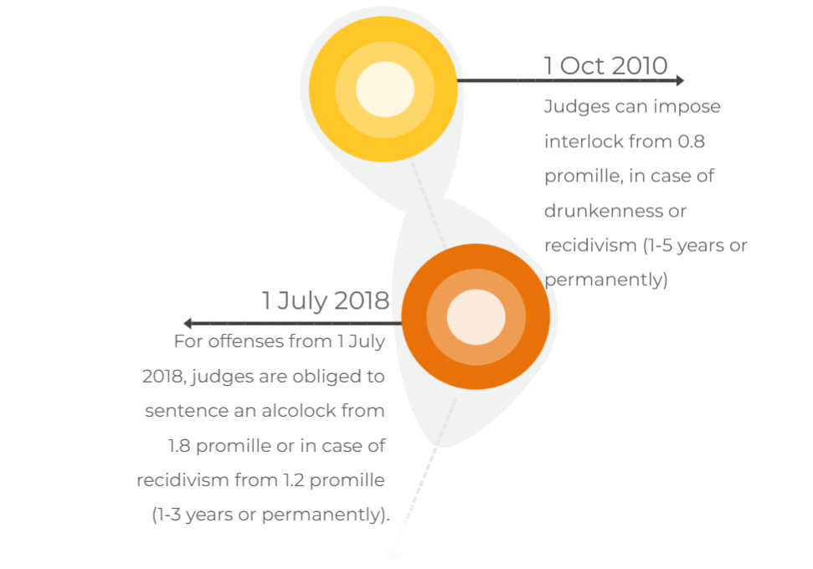

Alcohol Interlock legislation in BE
BE legislative history
Law of 12/07/2009 and royal decrees of 26/11/2010
Law 6/03/2018

Slide 5
Targeted offenders for alcohol interlock
Judge MUST impose
- severe intoxication (≥1.8 BAC)
unless properly motivated
- ≥1.2 BAC for repeat offenders no exception possible
= 1 – 3 years/ for life
Judge MAY impose
- intoxication ≥ 0.8 BAC
- drunkenness
- slight recidivism
Heavy
drink-
drivers
The judge can exempt certain vehicle categories from interlock (e.g. bus/truck),
except the category of offense
Out of scope:
- alcohol addiction (driving ban)
- driving ban for life

Slide 6
Number of interlocks for offenders
2009-10: 1st legislation
2013: 1st device installed
2014: 7 offenders convicted
until 2017: only 66 persons in monitoring program
2018: 2nd legislation
2019: 165 installations (>2900 convictions)
2020: 600 installations (>3800 convictions)
2021: 860 installations
2022: 960 installations
2023: > 1000 installations
2024: 1282 installations (>2500 programs ongoing )
Notes:
it seemed a real flop
the cape of 1,000 installations was crossed

Slide 7



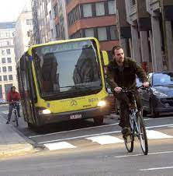



Notification of the judgment by public prosecutor to convicted person: choice to make
No interlock
No more driving
during same period
2. Alcohol Interlock

Slide 8

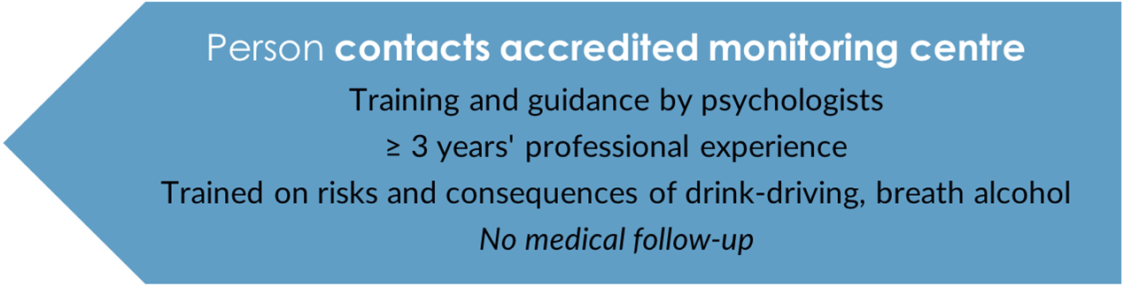



Monitoring program: a roadmap (1/3)
Notification of the judgment by
public prosecutor
Notes:
constitution and breakdown of breath alcohol
circumventing the system (e.g. having someone else blow and subsequently test positive again, or drink-driving)

Slide 9


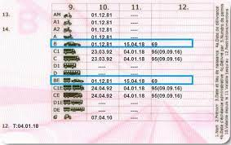




Monitoring program: a roadmap (2/3)
Installation of the device in accredited service centre
- within 30 days

Slide 10



Monitoring program: a roadmap (3/3)
Periodic downloads of registration unit by service centre every 2 months (after 1 year every 6 months).
Data stored on a secured place and only readable by monitoring centre
Every time an evaluation of these data by monitoring centre. Whenever necessary and at least twice a year:
individual guidance interview
Closing meeting
Removal of the device

Slide 11
Conditions to fulfill during monitoring program
pay costs in time
duly participate in the program
not drink drive anymore (≤ 0.2 BAC)
not too often try to start under influence
not disconnect or circumvent the system (abnormal results)
if not: program comes to early end & monitoring centre notifies public prosecutor in detail
public prosecutor can summon before court (judge: imprisonment, driving ban, fine)
Notes:
negative initial test followed by positive retest

Slide 12
Consequences of conviction
1
2
3
4
Device
Monitoring program
Driving ban
(+ tests)
Fine
Min. €1 600
Min. € 3 200 for repeat offense
1 year: € 1 200
3 years: € 1 700
1 year: € 2 250
3 years: € 4 100
Theory test
Practical test
Psych eval
Medical test
Judge can allow deduction of the costs from the fine

Slide 13


Costs
1 year: € 3500
3 years: € 6000
65 – 70% device and downloads
30 – 35% monitoring program
How to lower the huge costs?
Judges can allow deduction of the costs from the fine
Monitoring program: pay by instalments
Device to rent (30%)/ purchase (70%)
Open market for monitoring centres, service centres and model-approved devices
Second hand market
2
3
Device
Monitoring program
Driving ban
(+ tests)
1 year: € 1 200
3 years: € 1 700
1 year: € 2 250
3 years: € 4 100
Theory test
Practical test
Psych eval
Medical test

Slide 14
Our good strategies
1, Convince and even push judges (but give some margin)
2, Monitoring program as a game changer
4, Several manufacturers: lower prices, different accents like allow rental
5, Territorial coverage of service centres (2: 33) and monitoring centres (4: 74)
6, A program of 5 years is too long; 1-3 years can cause positive behavorial changes
7, Keep device afterwards - helps keeping up good habits (without program)
8, Threshold at 0.2 pm (zero tolerance)
3, Annual verification of device by an accredited body (independency)
2
3
Device
Monitoring program
Driving ban
(+ tests)
1 year: € 1 200
3 years: € 1 700
1 year: € 2 250
3 years: € 4 100
Theory test
Practical test
Psych eval
Medical test
Notes:
3 models approved

Slide 15


Our issues
1, Time gap between offence and sanction: 12 to 18 months
2, Alcohol dependency or not (driving ban versus interlock)?
No standard medical check
3, Judges often opt out if they can (first offenders)
4, Retests while driving to counter circumvention (retest to be completed within 15’)
5, Combination driving ban (+ tests) + interlock = complex
Subsequent decisions may need proper arrangements with public prosecutor
2
3
Device
Monitoring program
Driving ban
(+ tests)
1 year: € 1 200
3 years: € 1 700
1 year: € 2 250
3 years: € 4 100
Theory test
Practical test
Psych eval
Medical test

Slide 16

Alcohol interlocks: win – win
Safe roads
Afterwards: some studies show behaviour change if monitored
Possibility to keep on driving (social & professional life)
During interlock period: chance on drink driving - 75%
Monitoring program helps for lasting behaviour change
2
3
Device
Monitoring program
Driving ban
(+ tests)
1 year: € 1 200
3 years: € 1 700
1 year: € 2 250
3 years: € 4 100
Theory test
Practical test
Psych eval
Medical test
Video ETSC: "It has changed my life..." - How alcohol interlocks can save lives and change lives - YouTube

Slide 17
Measures announced by the new government in the fight against drink-driving (2025-29):
Repeat offenders ≥0,5 BAC automatically referred to court.
Mandatory interlock for repeat offenders ≥0.8 BAC (unless exception by judge).
Interlock suitable for addicts?
2
3
Device
Monitoring program
Driving ban
(+ tests)
1 year: € 1 200
3 years: € 1 700
1 year: € 2 250
3 years: € 4 100
Theory test
Practical test
Psych eval
Medical test
Notes:
Explore the question if interlock is suitable for addicts.

Slide 18


anneliese.heeren@mobilit.fgov.be
FPS Mobility and Transport
Thank you for your attention!

